Slide 1


Introduction to Cloud Computing with R in Google Cloud and Amazon Web Services Session 4 : Running R in Amazon Web Services Platform
Sounak Chakraborty
Associate Professor, Department of Statistics
http://faculty.missouri.edu/chakrabortys/

Slide 2
What we will learn in this session ?
We will Learn how to run R code in Amazon Web Services (AWS) platform. You can also run Python in AWS.
You need to have a AWS account for this.
Amazon gives you free trial account for 12 months. After that you need to pay. The free policies often change.
AWS Free Tier includes 750 hours of Linux and Windows t2.micro instances, ( t3.micro for the regions in which t2.micro is unavailable) each month for one year. To stay within the Free Tier, use only EC2 Micro instances.
Detail pricing information can be found in https://aws.amazon.com/ec2/pricing/
You should have already set up your AWS account to proceed further in this session following the guidelines in softwarerequirements.pptx slide.

Slide 3
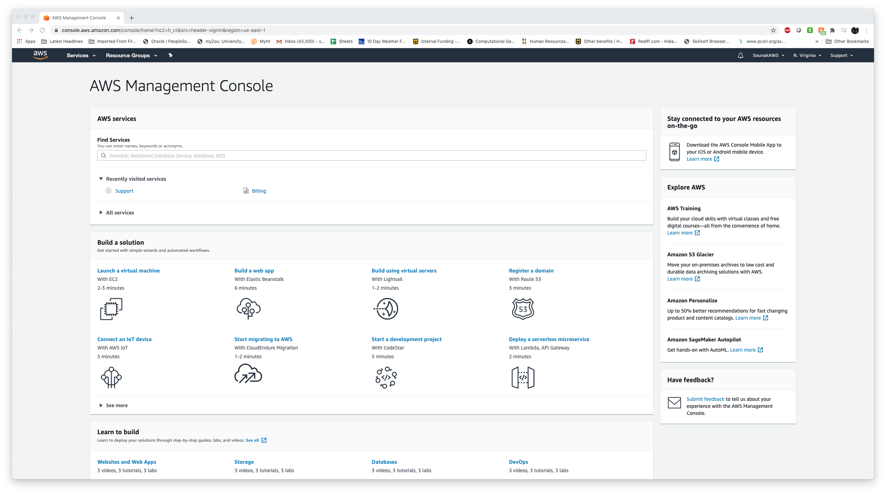
Lets begin
Go to https://aws.amazon.com/ and Login to your AWS account
You will arrive at the AWS Management Console

Slide 4
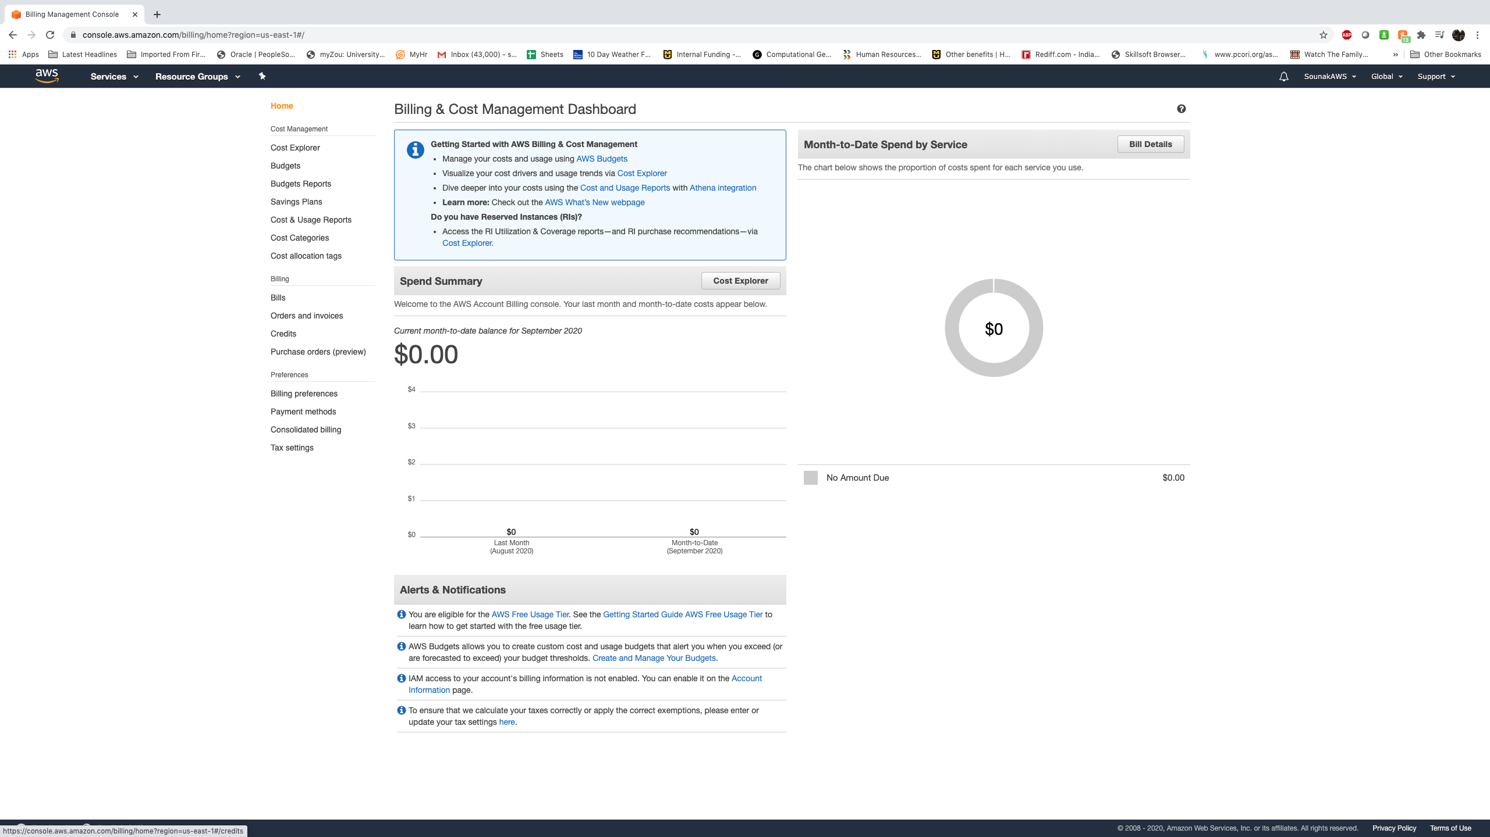
Billing page

Slide 5
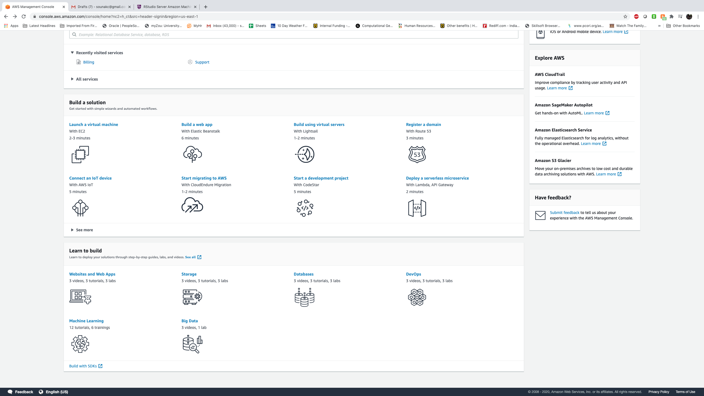

Chose a computer/virtual machine (vm)
Amazon’s EC2 platform provides a convenient environment for rapidly procuring computational resources or VM in the cloud.
Our interest is specifically in statistical computation with R and RStudio Server in AWS cloud.

Slide 6
Creating a Amazon Machine Image (AMI) virtual machine
Amazon Machine Image (AMI) is similar concept as the virtual machine
In AWS you need to create your Amazon Machine Image (AMI) under Amazon’s EC2 platform
This will involve choosing the operating system, CPU, RAM, hard drive, and installing necessary softwares like R, RStudio etc. Similar steps we have navigated in GCP session.
For AWS we will do it in two different ways
use a predefined/created AMI for your purpose and run your codes. It means someone has already created an ami which you can readily use. You are not using anyone else’s machine you are just using the image. It is similar to tracing a picture with a pencil.
Create our own AMI from scratch and install all necessary components by ourselves. Will be a bit time consuming compared to the previous option.

Slide 7
Predefined ami
It will be extremely fast to create based on that and run your jobs.
However it depends on the match you are looking for.
If you have no very specialized need and the predefined ami has all necessary softwares and other platforms satisfying your need we can go through that route to run your R jobs in AWS.
The base operating system installs will be Debian or Ubuntu
The AMI we will adopt is specifically targeted at R and RStudio Server with the goal of making it a 1-minute job to get going for anyone with an AWS account.

Slide 8
What we would have in the Predefined ami ?
Rstudio 1.3.1073 with 30GB store
R 4.0.2
Easy to use Dropbox integration to up/down-load files and data
LaTeX support enabling R Markdown
Database support: RMySQL package precompiled and installed.
full support for big data platforms: H2O and Spark
MCMC samplers:
Stan (RStan) installed and ready to use for Hamiltonian Monte Carlo sampling.
JAGS (and rjags) installed and ready to use for Gibbs sampling.
Greta supported for GPU MCMC sampling via Tensorflow support.
CUDA and cuDNN:
Enables immediate use of GPU instances without any setup.
Tensorflow and Keras deep learning libraries can be accelerated using nVidia GPUs on the GPU compute instances, just couple of lines of R code each to setup.
YOU HAVE ALMOST A PERFECT LY SET MACHINE FOR YOU IF YOU ARE A R ENTHUSIAST

Slide 9
Quick steps to access a predefine ami and have your Rstudio up and running in almost no time
Step 1: Log in to your AWS account
Step 2: Go to next slide, choose the region you want your virtual machines to stay, and click on the link next to it (e.g., ami-02bf650155c44b475 for US West, N. California). The link will directly lead you to the EC2 Management Console. It is advised you chose the region close to your geographic location.

Slide 10
AMI selection
Region | 64-bit HVM AMI
EU West, Ireland | ami-05bf201d51b1db642
EU West, London | ami-0b4be5cd9e848fabb
EU West, Paris | ami-005af3b164a016fac
EU Central, Frankfurt | ami-076abd591c4335092
EU North, Stockholm | ami-0fa80e7cbbc94e3b7
Canada, Central | ami-0bdd24fd36f07b638
US East, Virginia | ami-0f2290fdad793f863
US East, Ohio | ami-07083dcdc7b7e0160
US West, N. California | ami-01c4bf25032f468d5
US West, Oregon | ami-0dc8133a777c1be2c
South America, São Paulo | ami-0b900643456dfb4d9
Asia Pacific, Singapore | ami-0cba549926c171ab2
Asia Pacific, Tokyo | ami-00b6908a3a1faec83
Asia Pacific, Hong Kong | ami-9191d2e0
Asia Pacific, Seoul | ami-00c627e2e3173aeb7
Asia Pacific, Sydney | ami-0c48131b082d5cb01
Asia Pacific, Mumbai | ami-0136f51bfeac09417
Click any of the AMI links to launch AWS web interface.
Courtesy: https://www.louisaslett.com/RStudio_AMI/

Slide 11
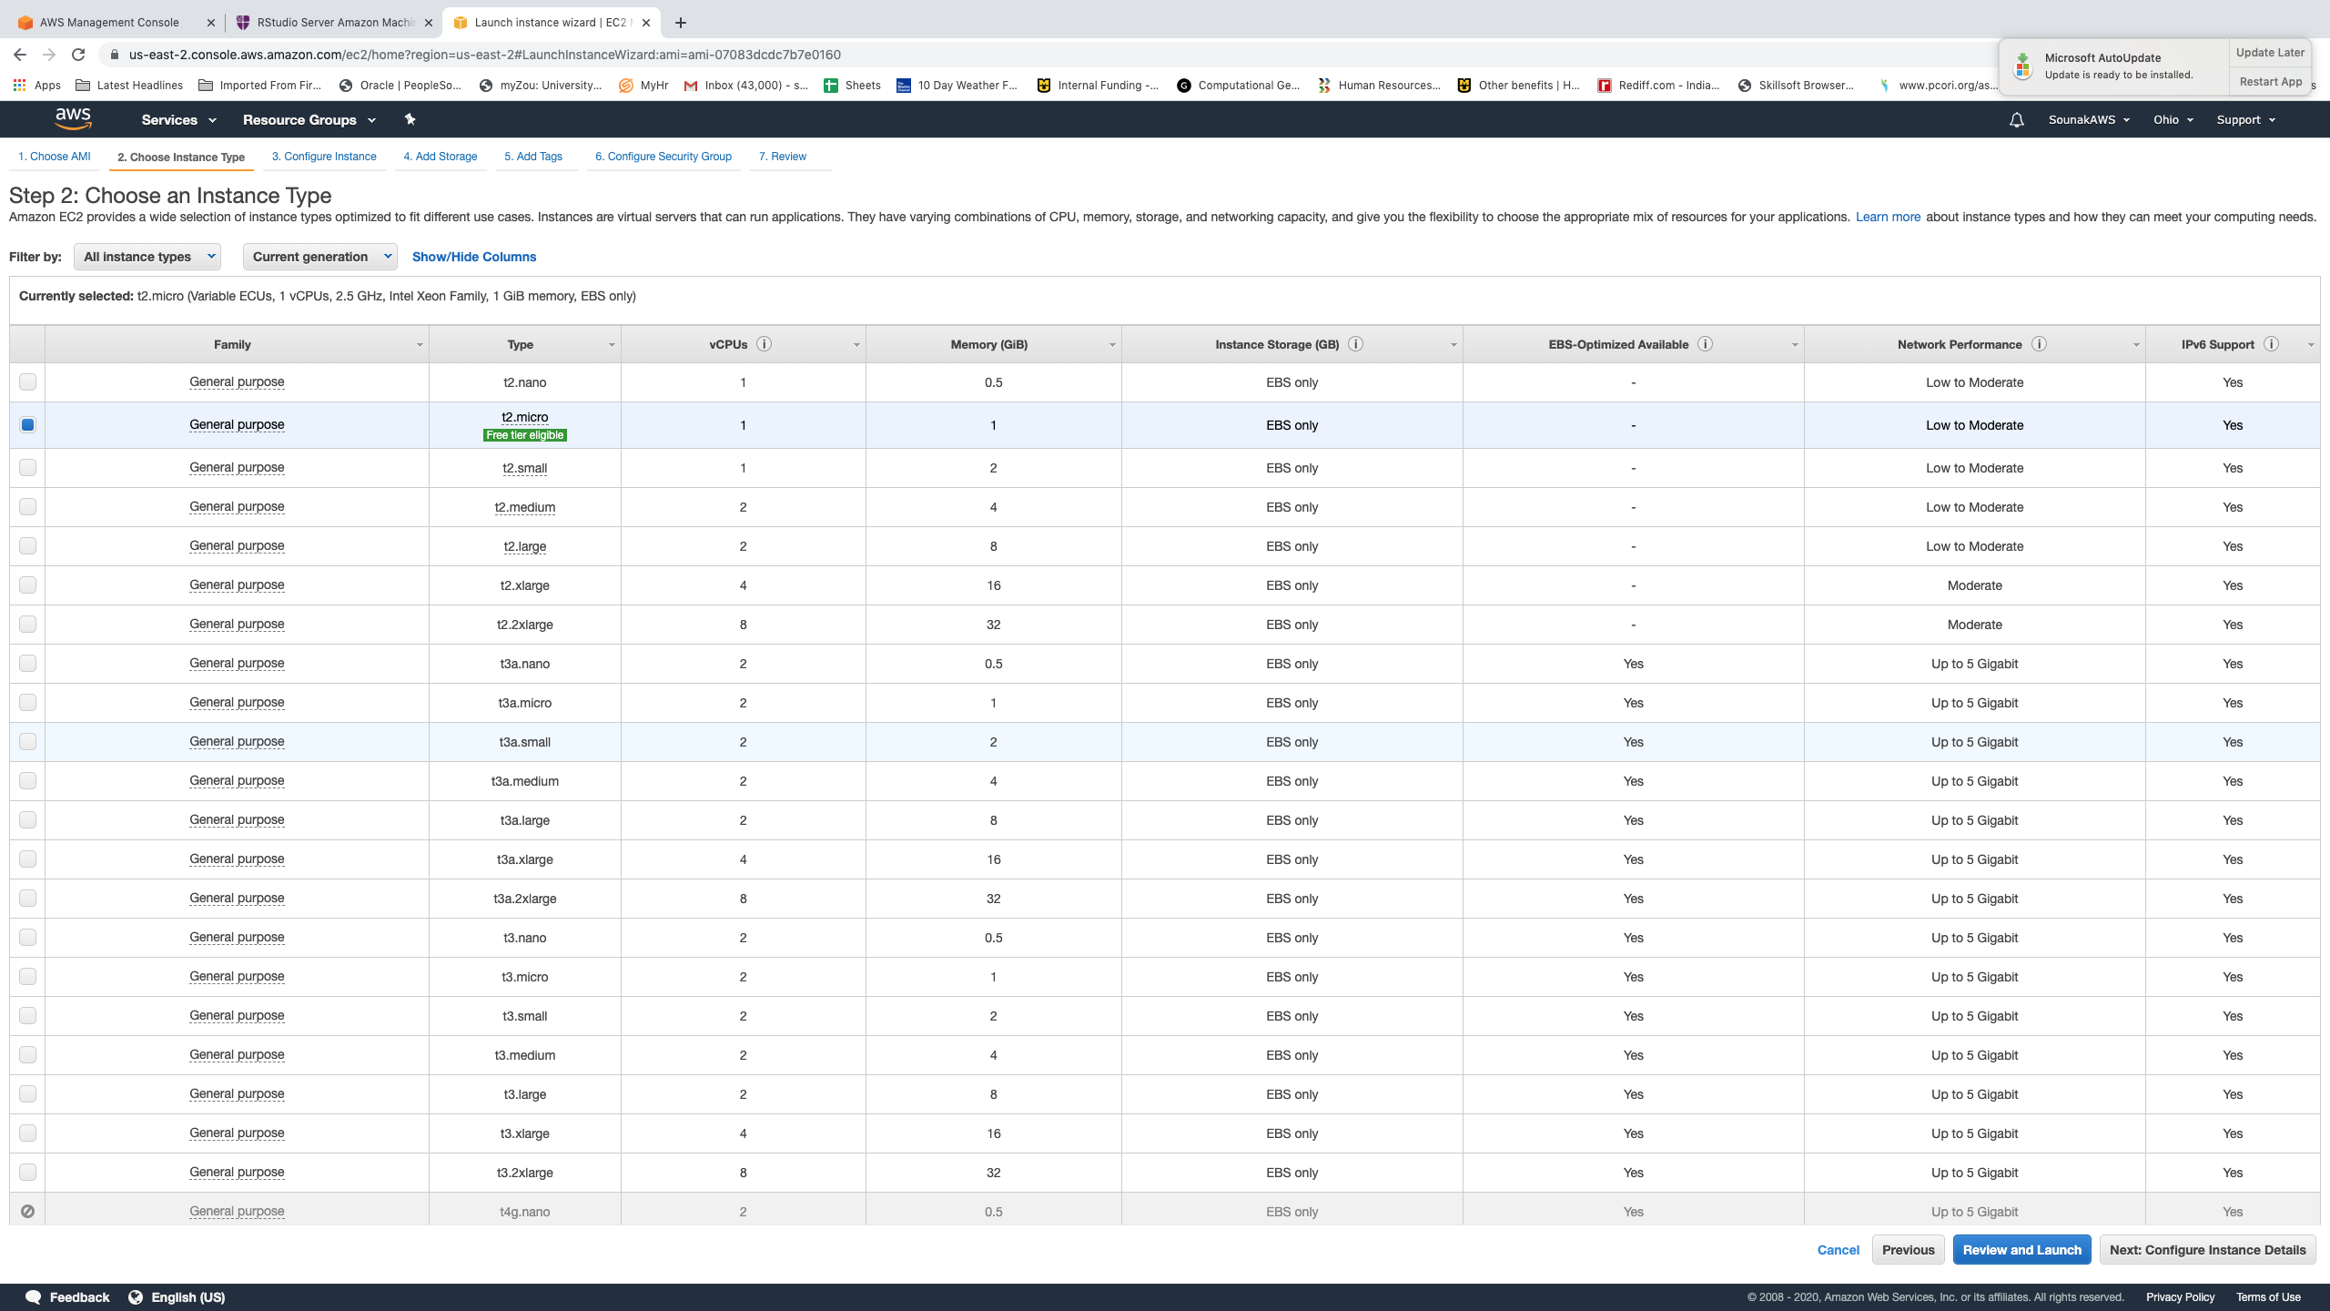
LIST of available ami
Step 3: Almost everything is already pre-filled out and your screen should look like the screenshots below. Don’t press “Review and Launch” yet. We need to go through the whole process once just to be sure, so press “Next: …”.

Slide 12
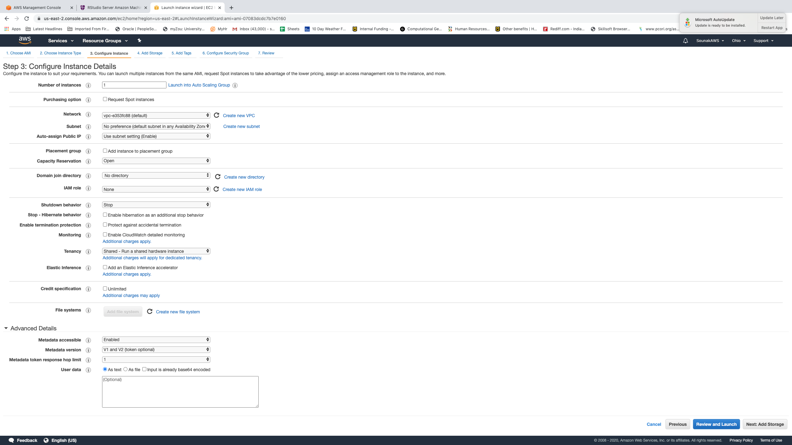

Configure instances

Slide 13
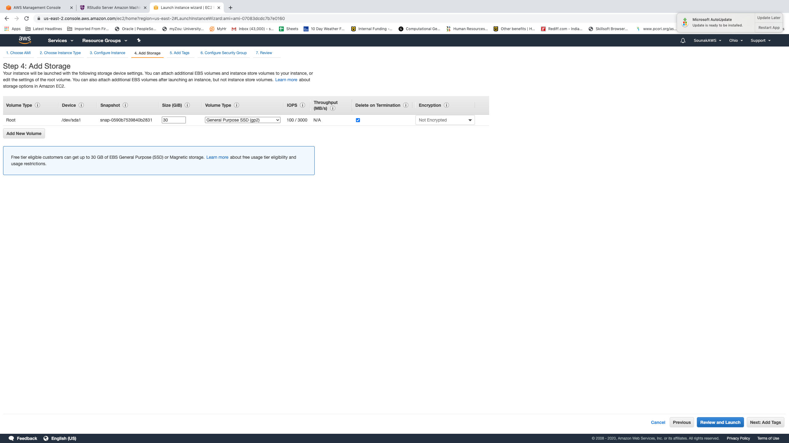
Modify storage

Slide 14
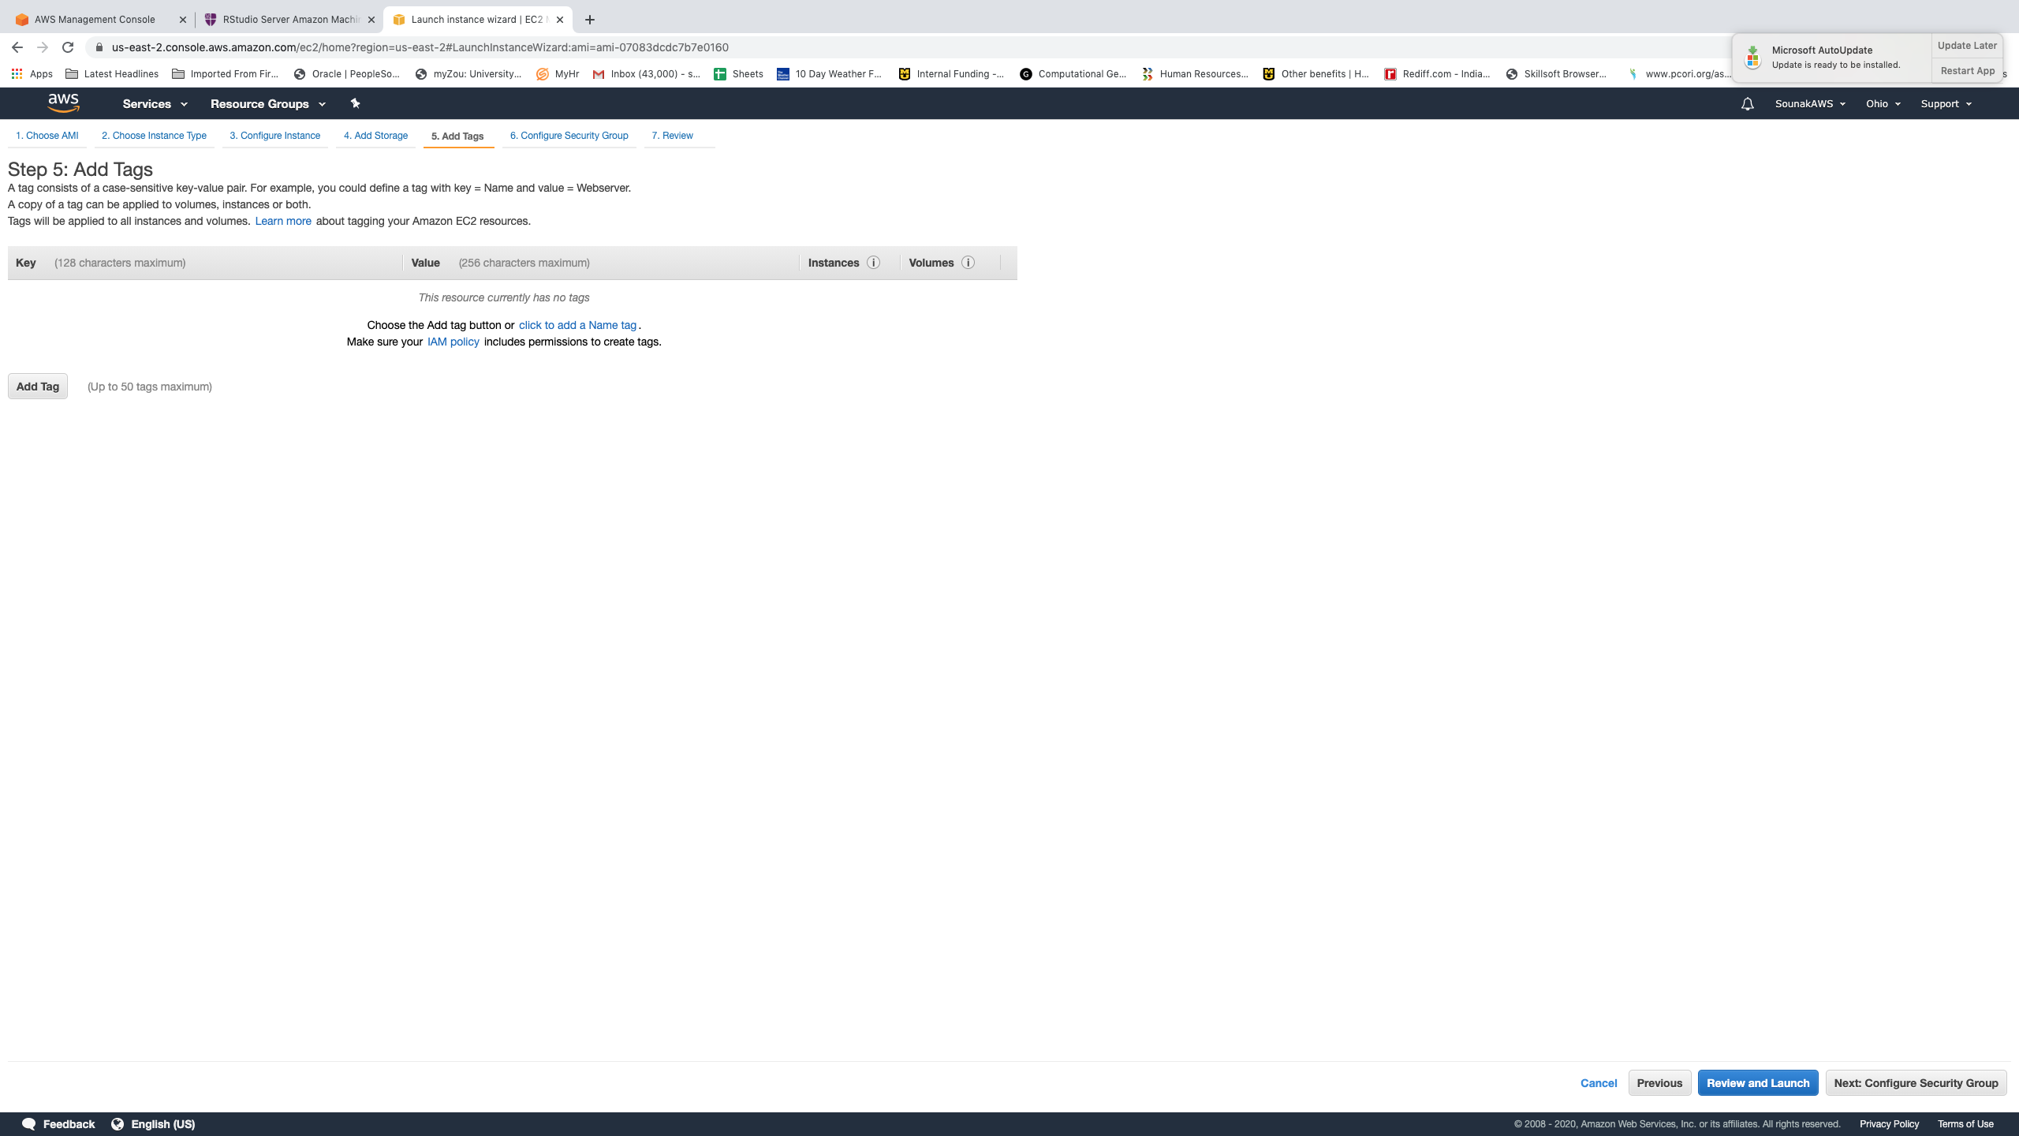

Add tags

Slide 15
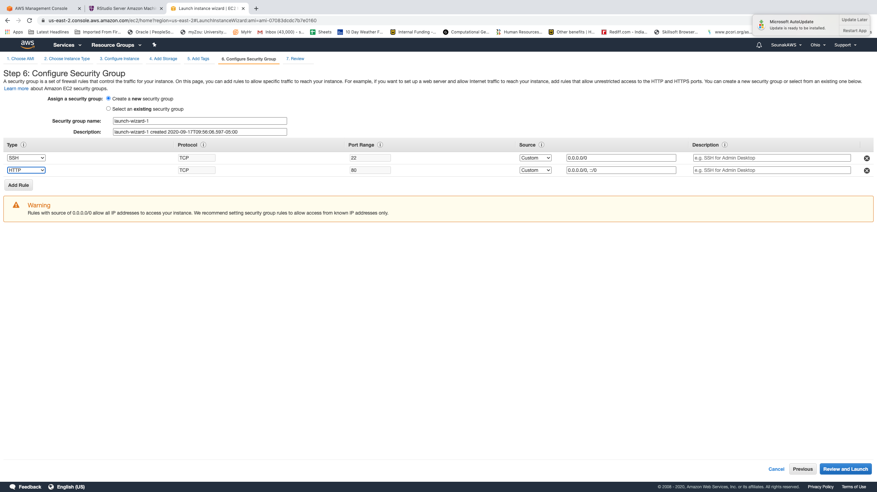

Security setting: Click on “Add Rule”, choose HTTP and change “Source” from Custom to Anywhere.

Slide 16
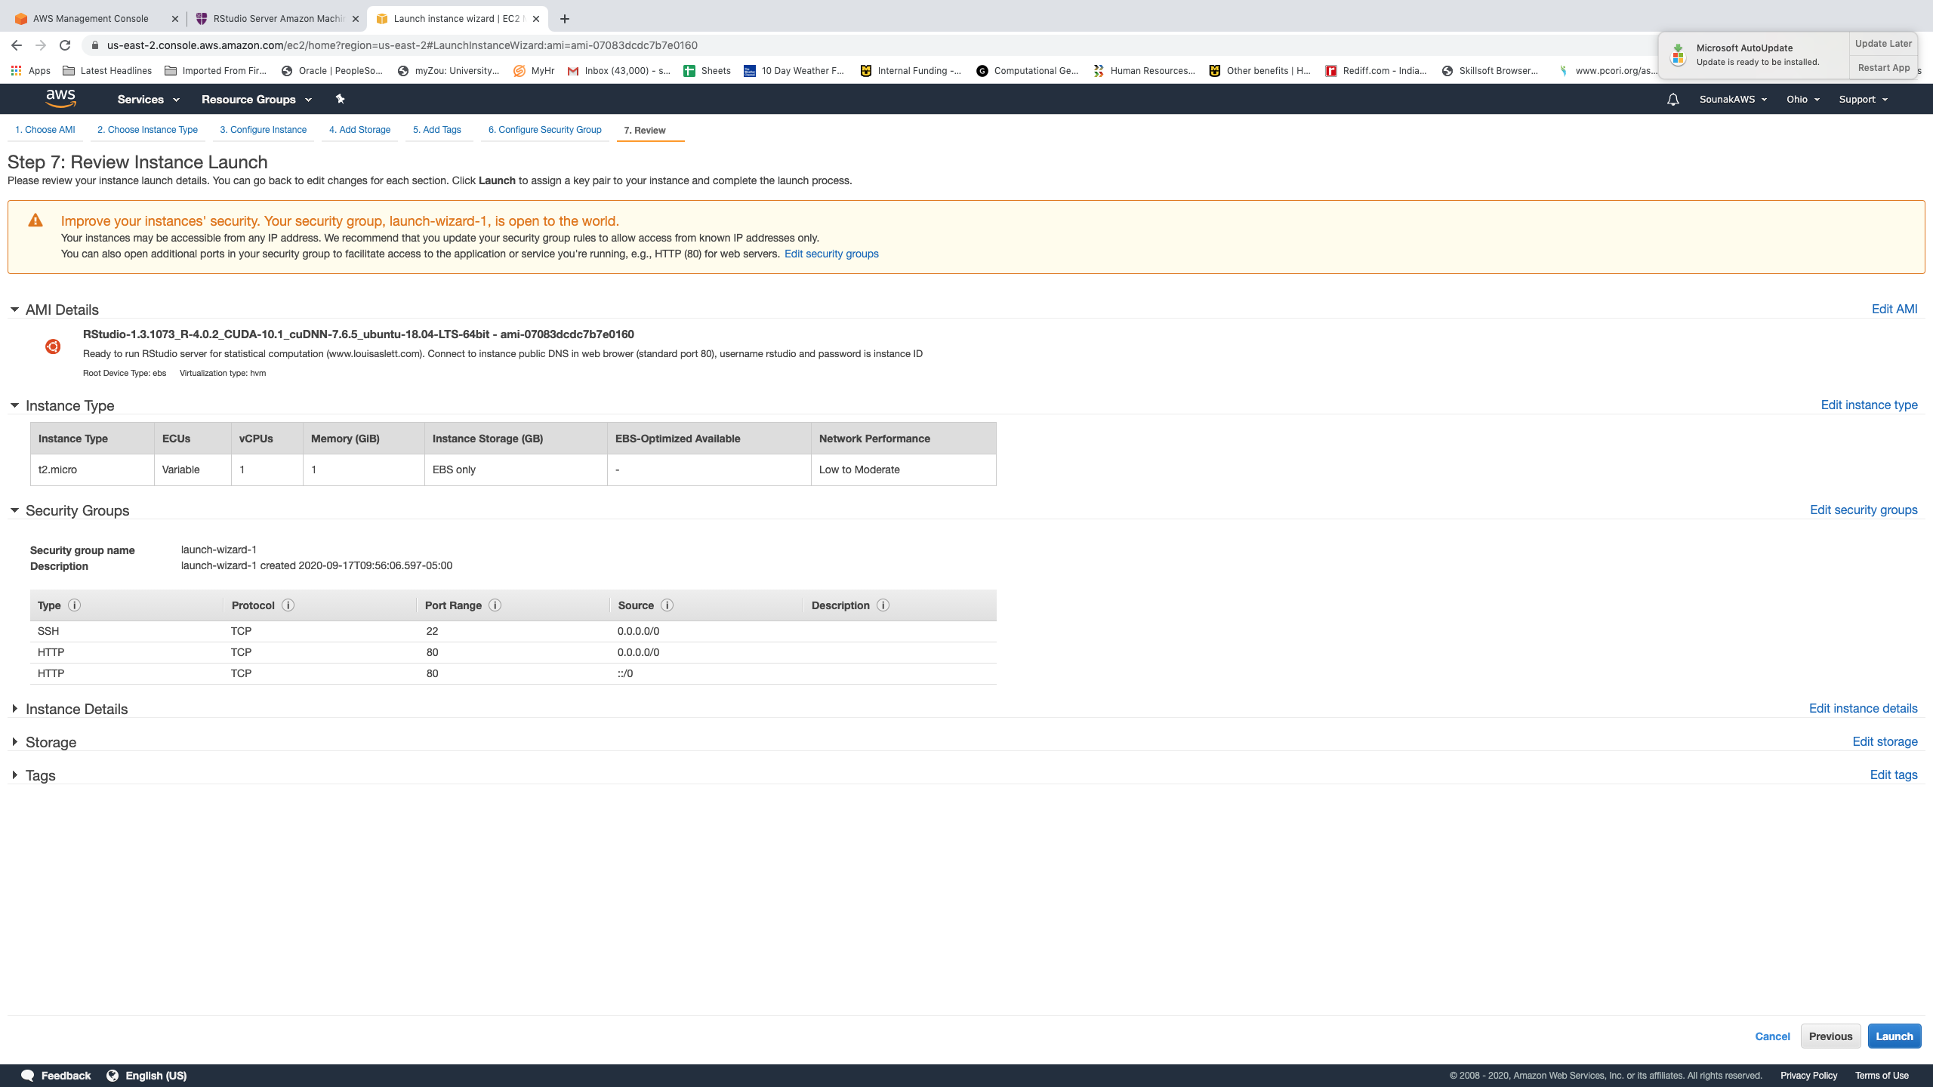
Review your created instance and click launch

Slide 17
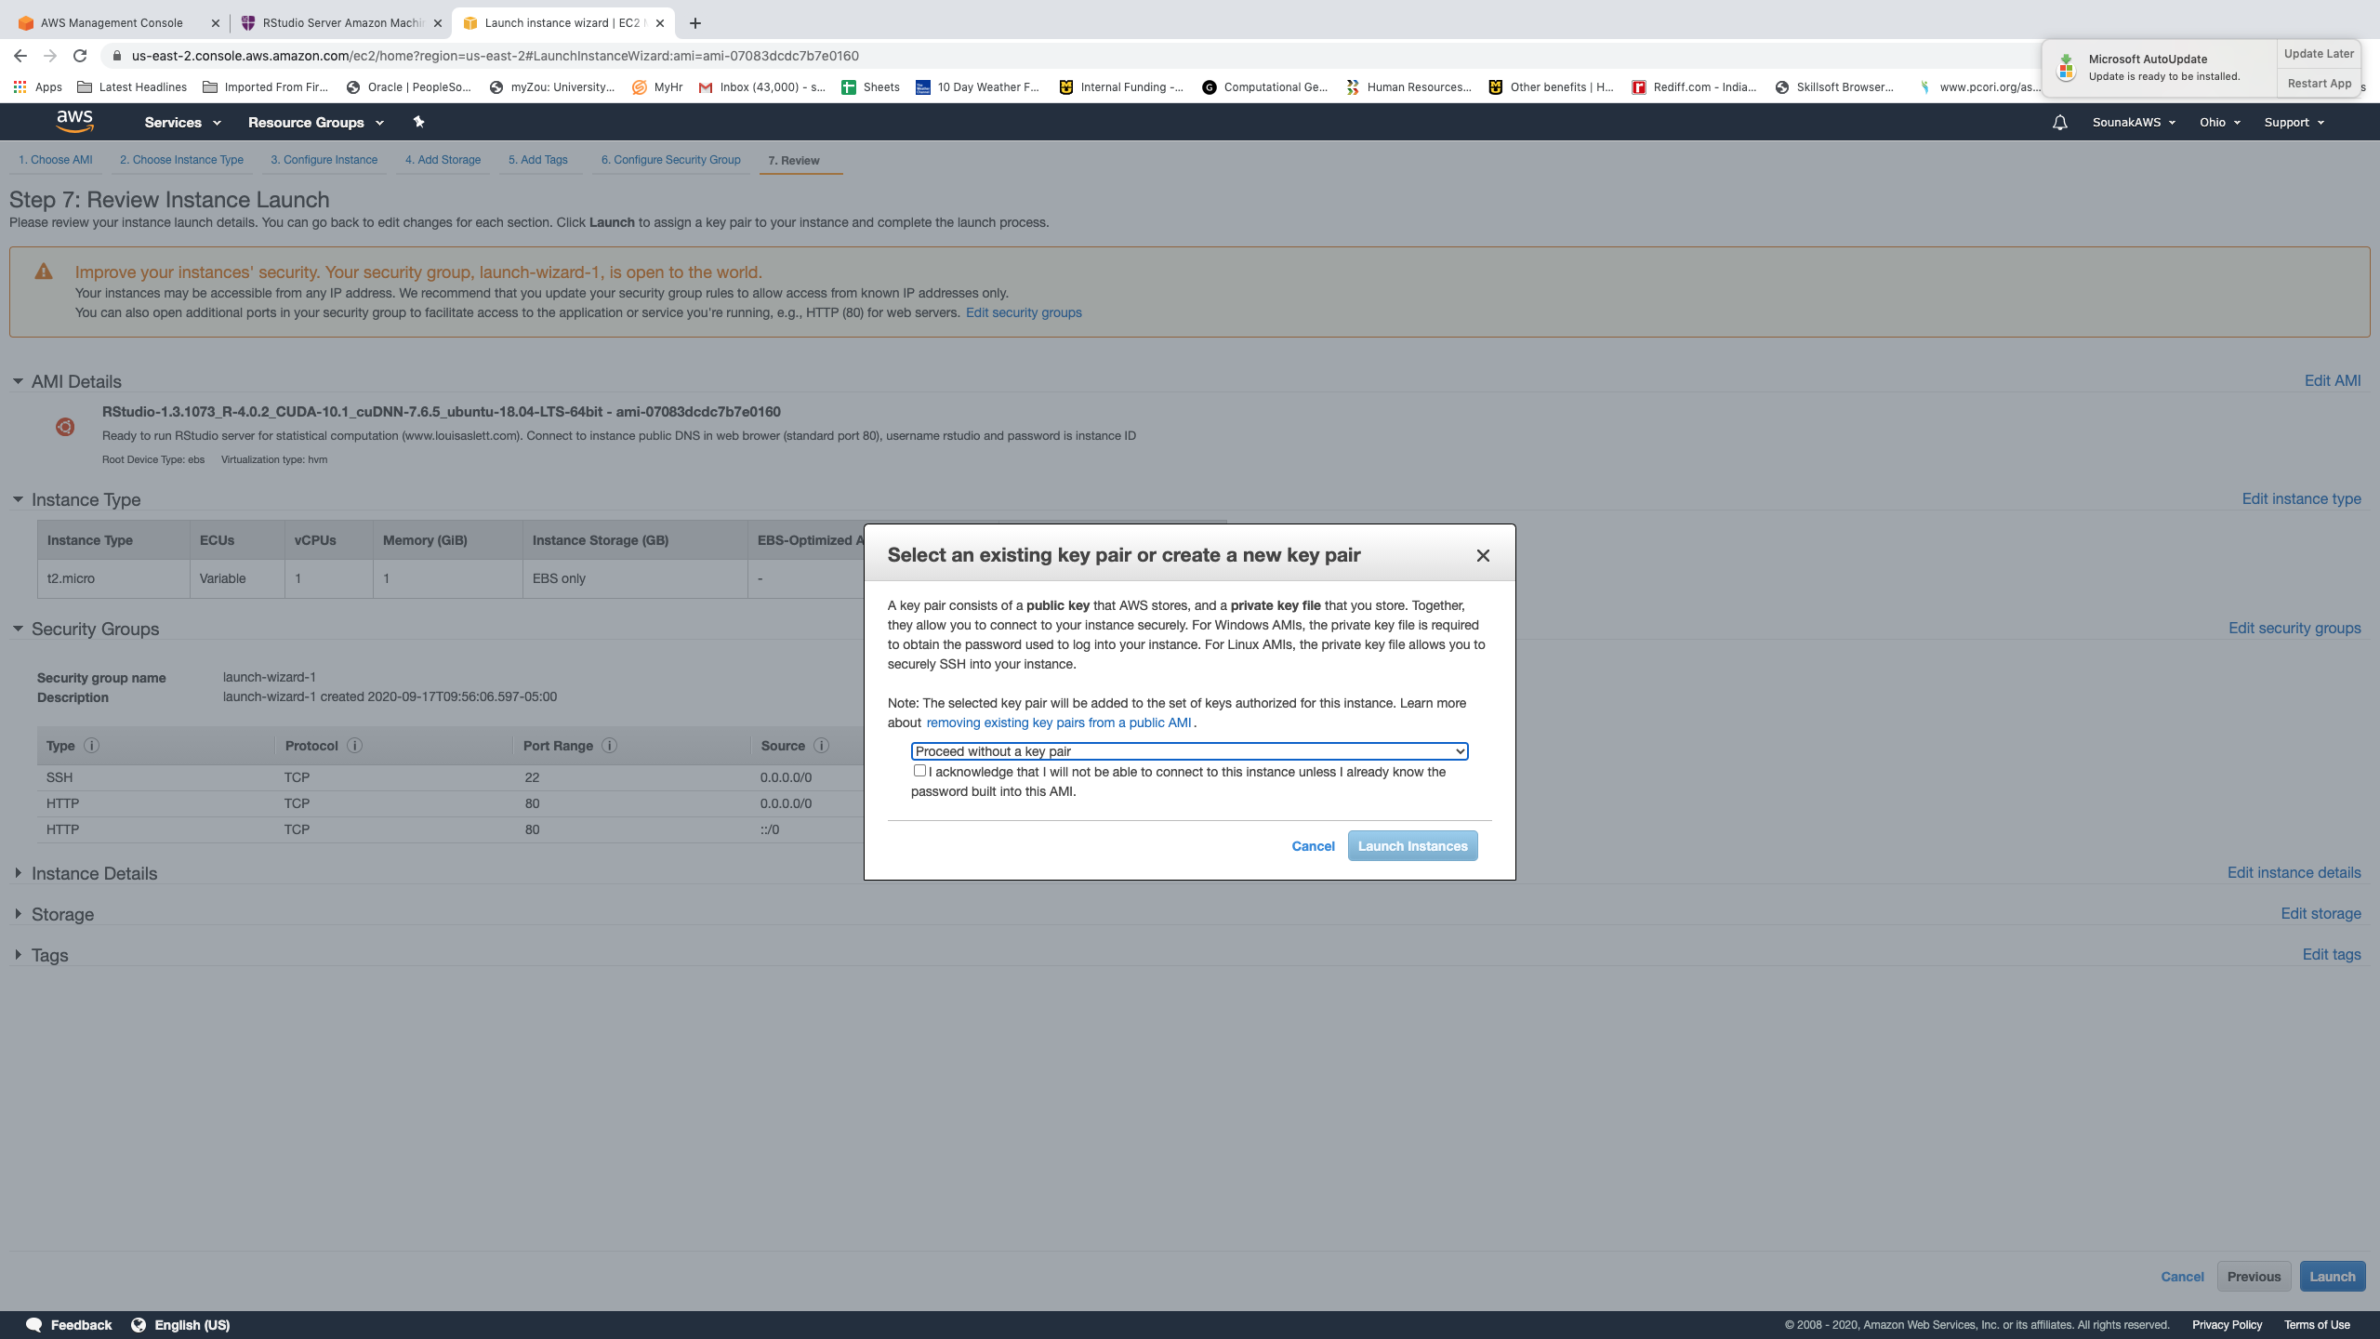

Choose Proceed without a key pair. Click launch instances. It may take few mins for aws to create your ami.

Slide 18
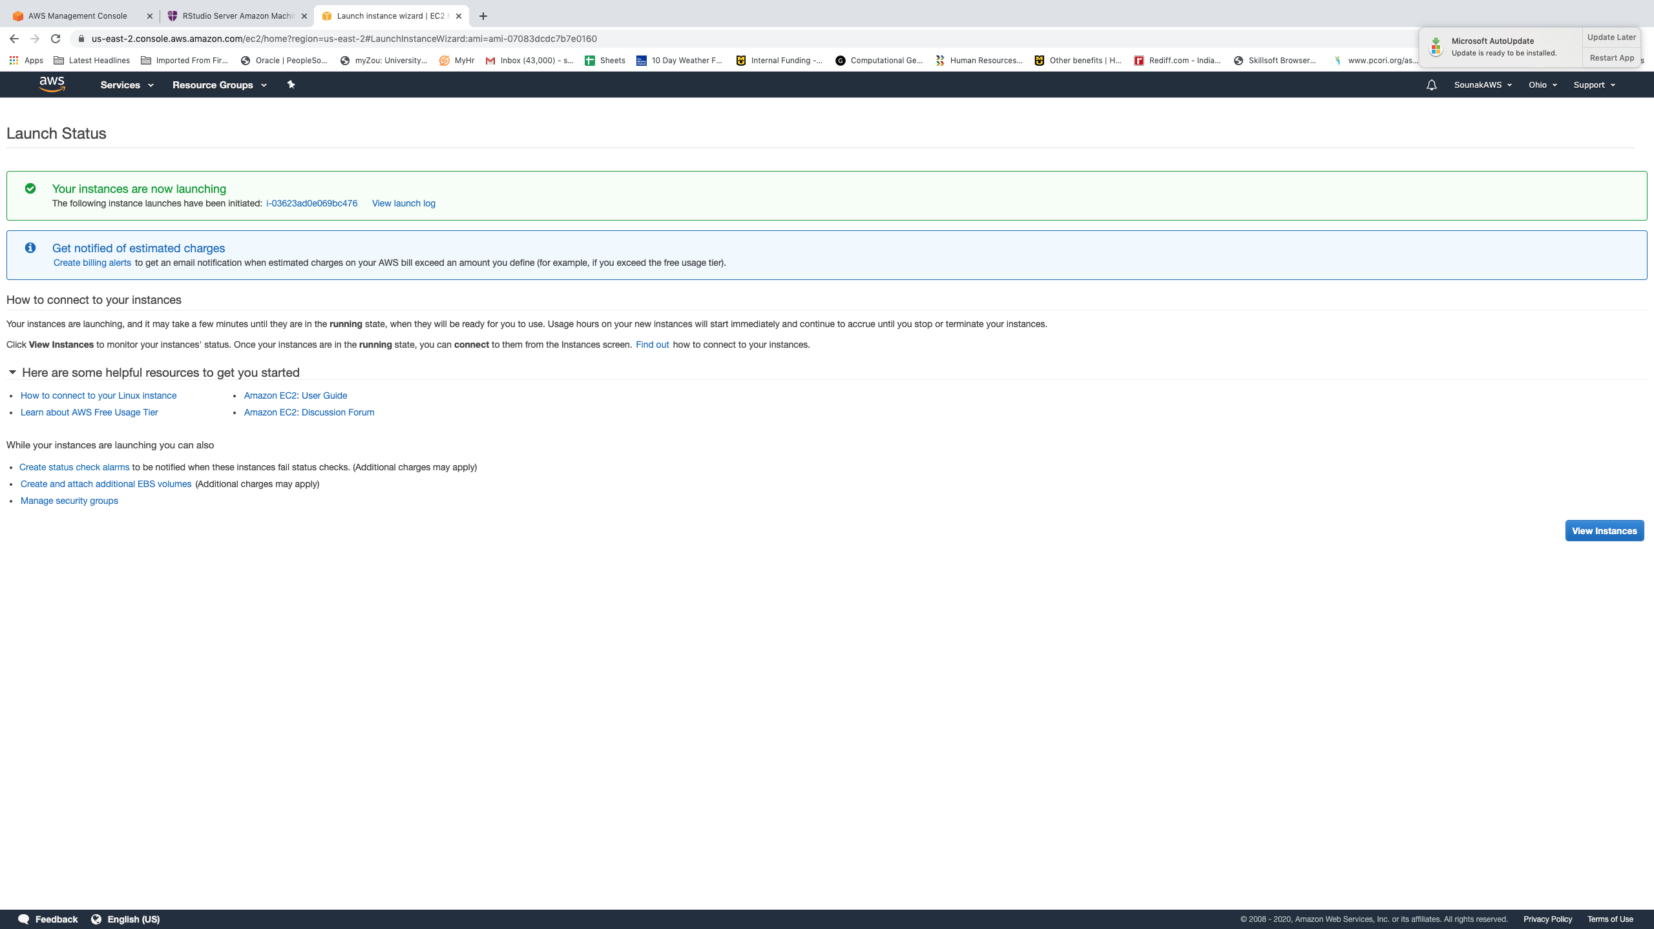

Click view instances

Slide 19
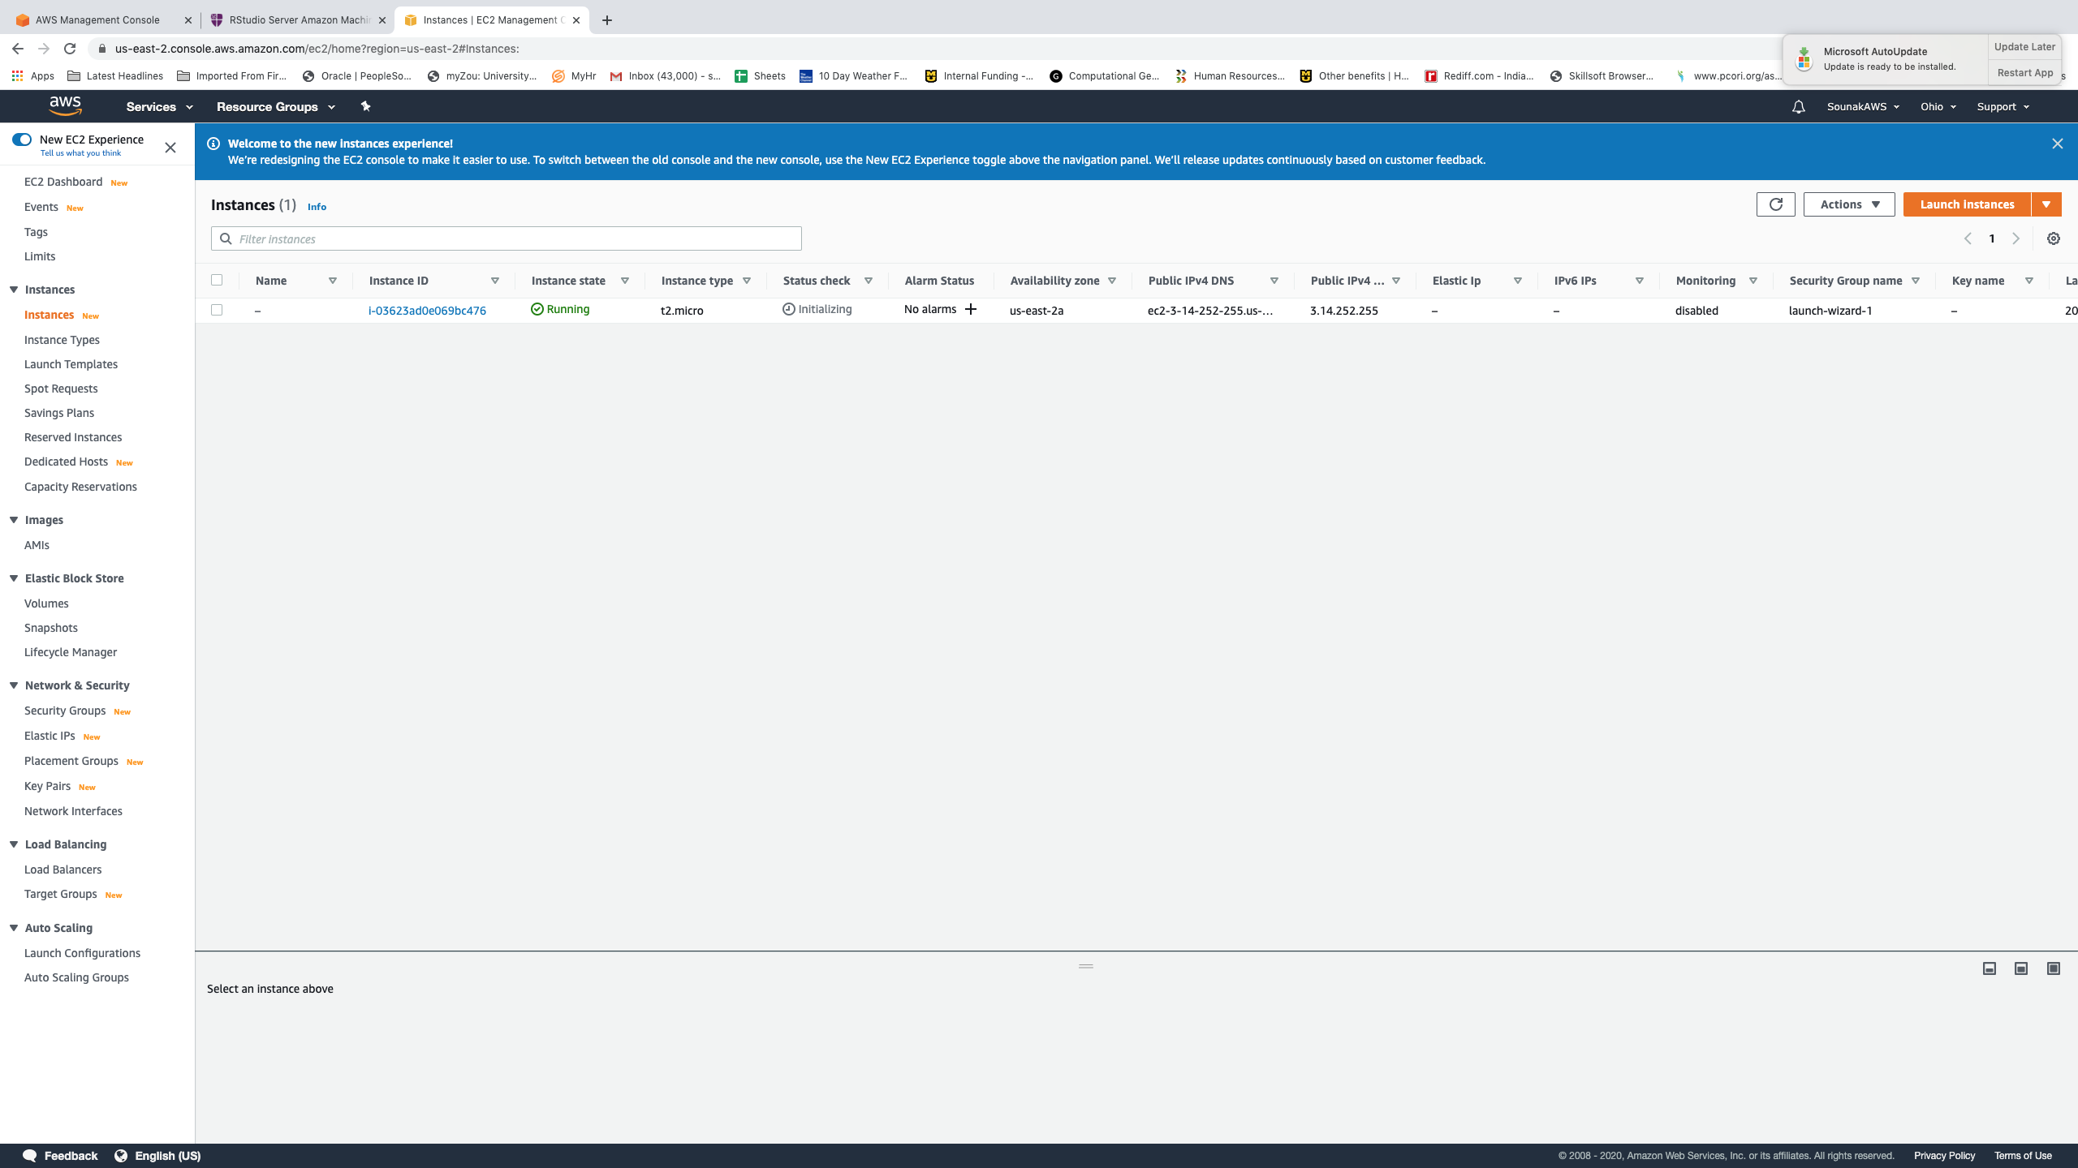

List of instances. Click on instance id to see details.

Slide 20
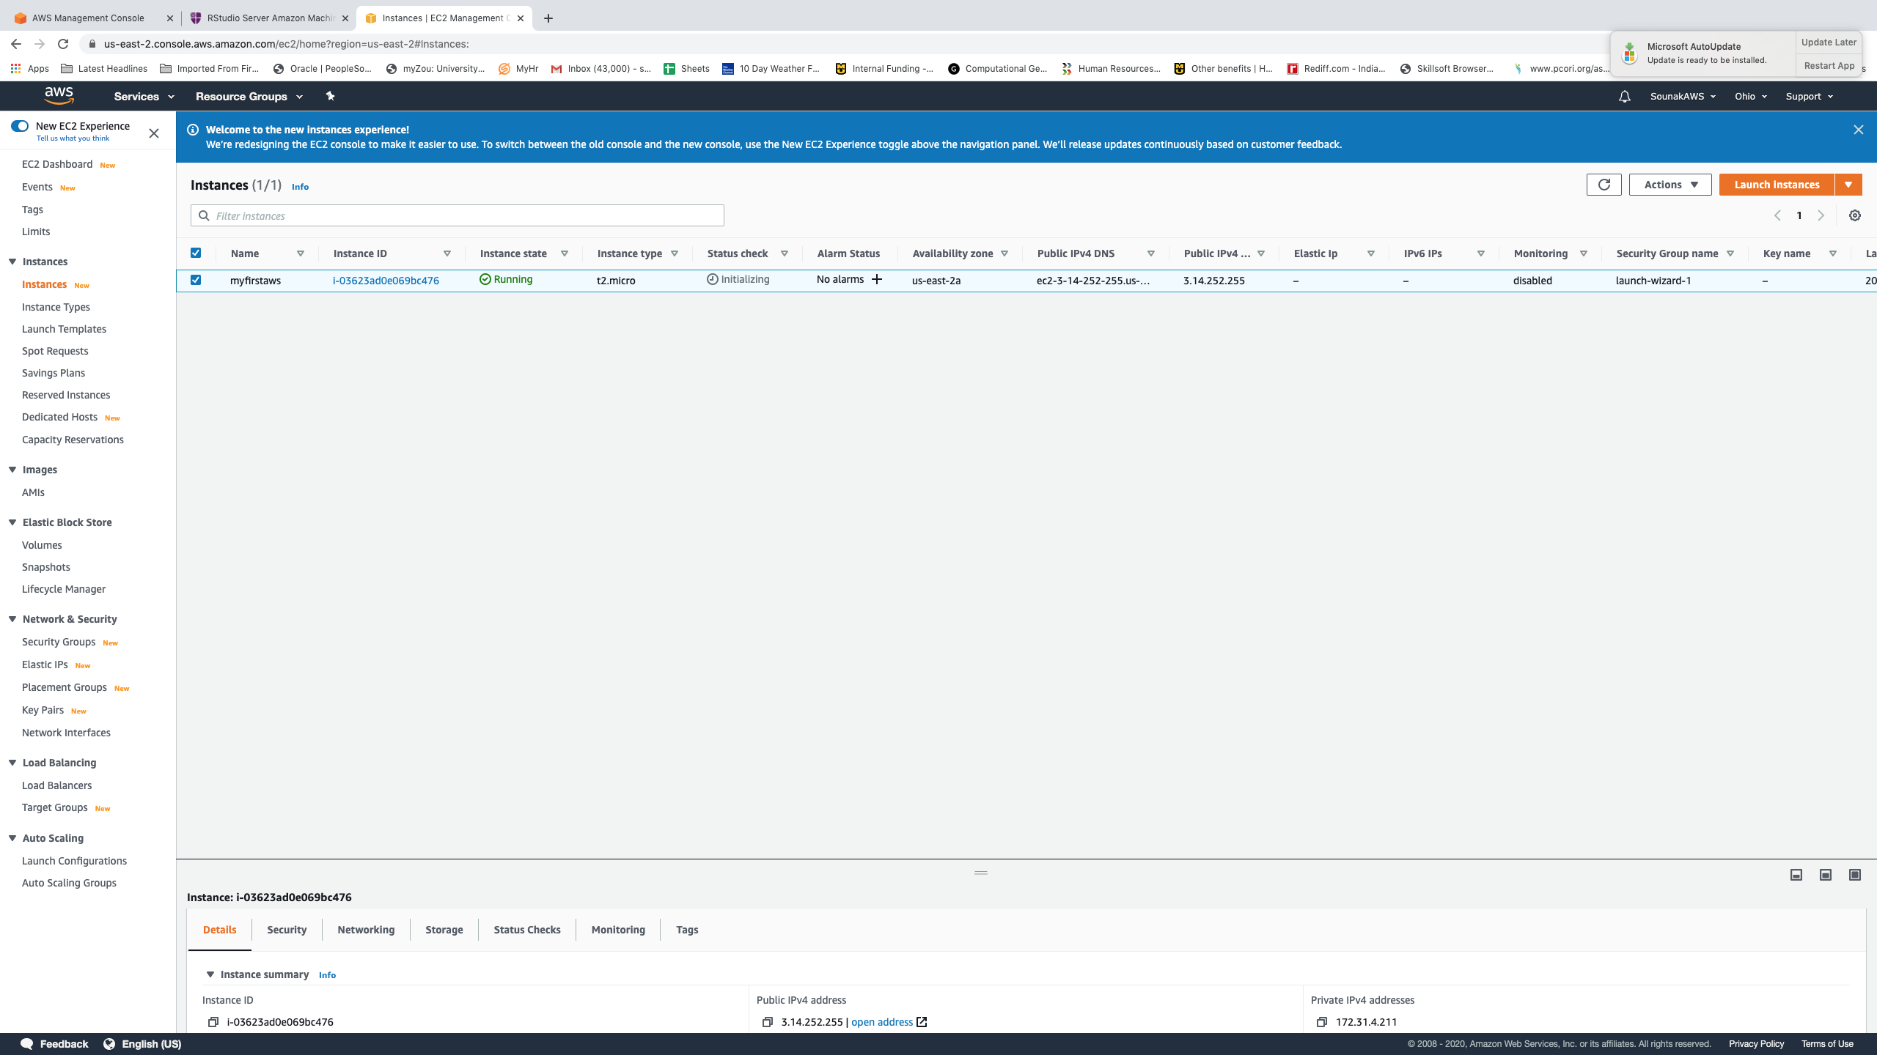
Assigning name to your instance

Slide 21
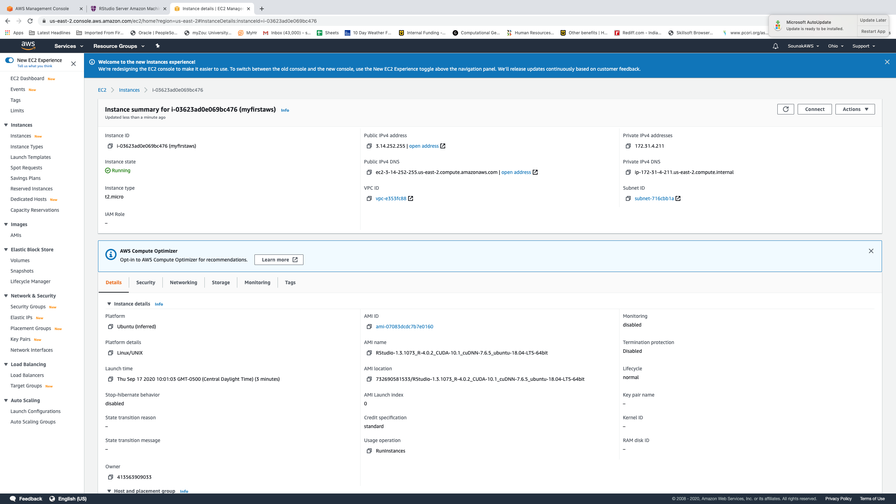

Instance details. Copy instance ID. Click on IPV4 to launch rstudio server.

Slide 22
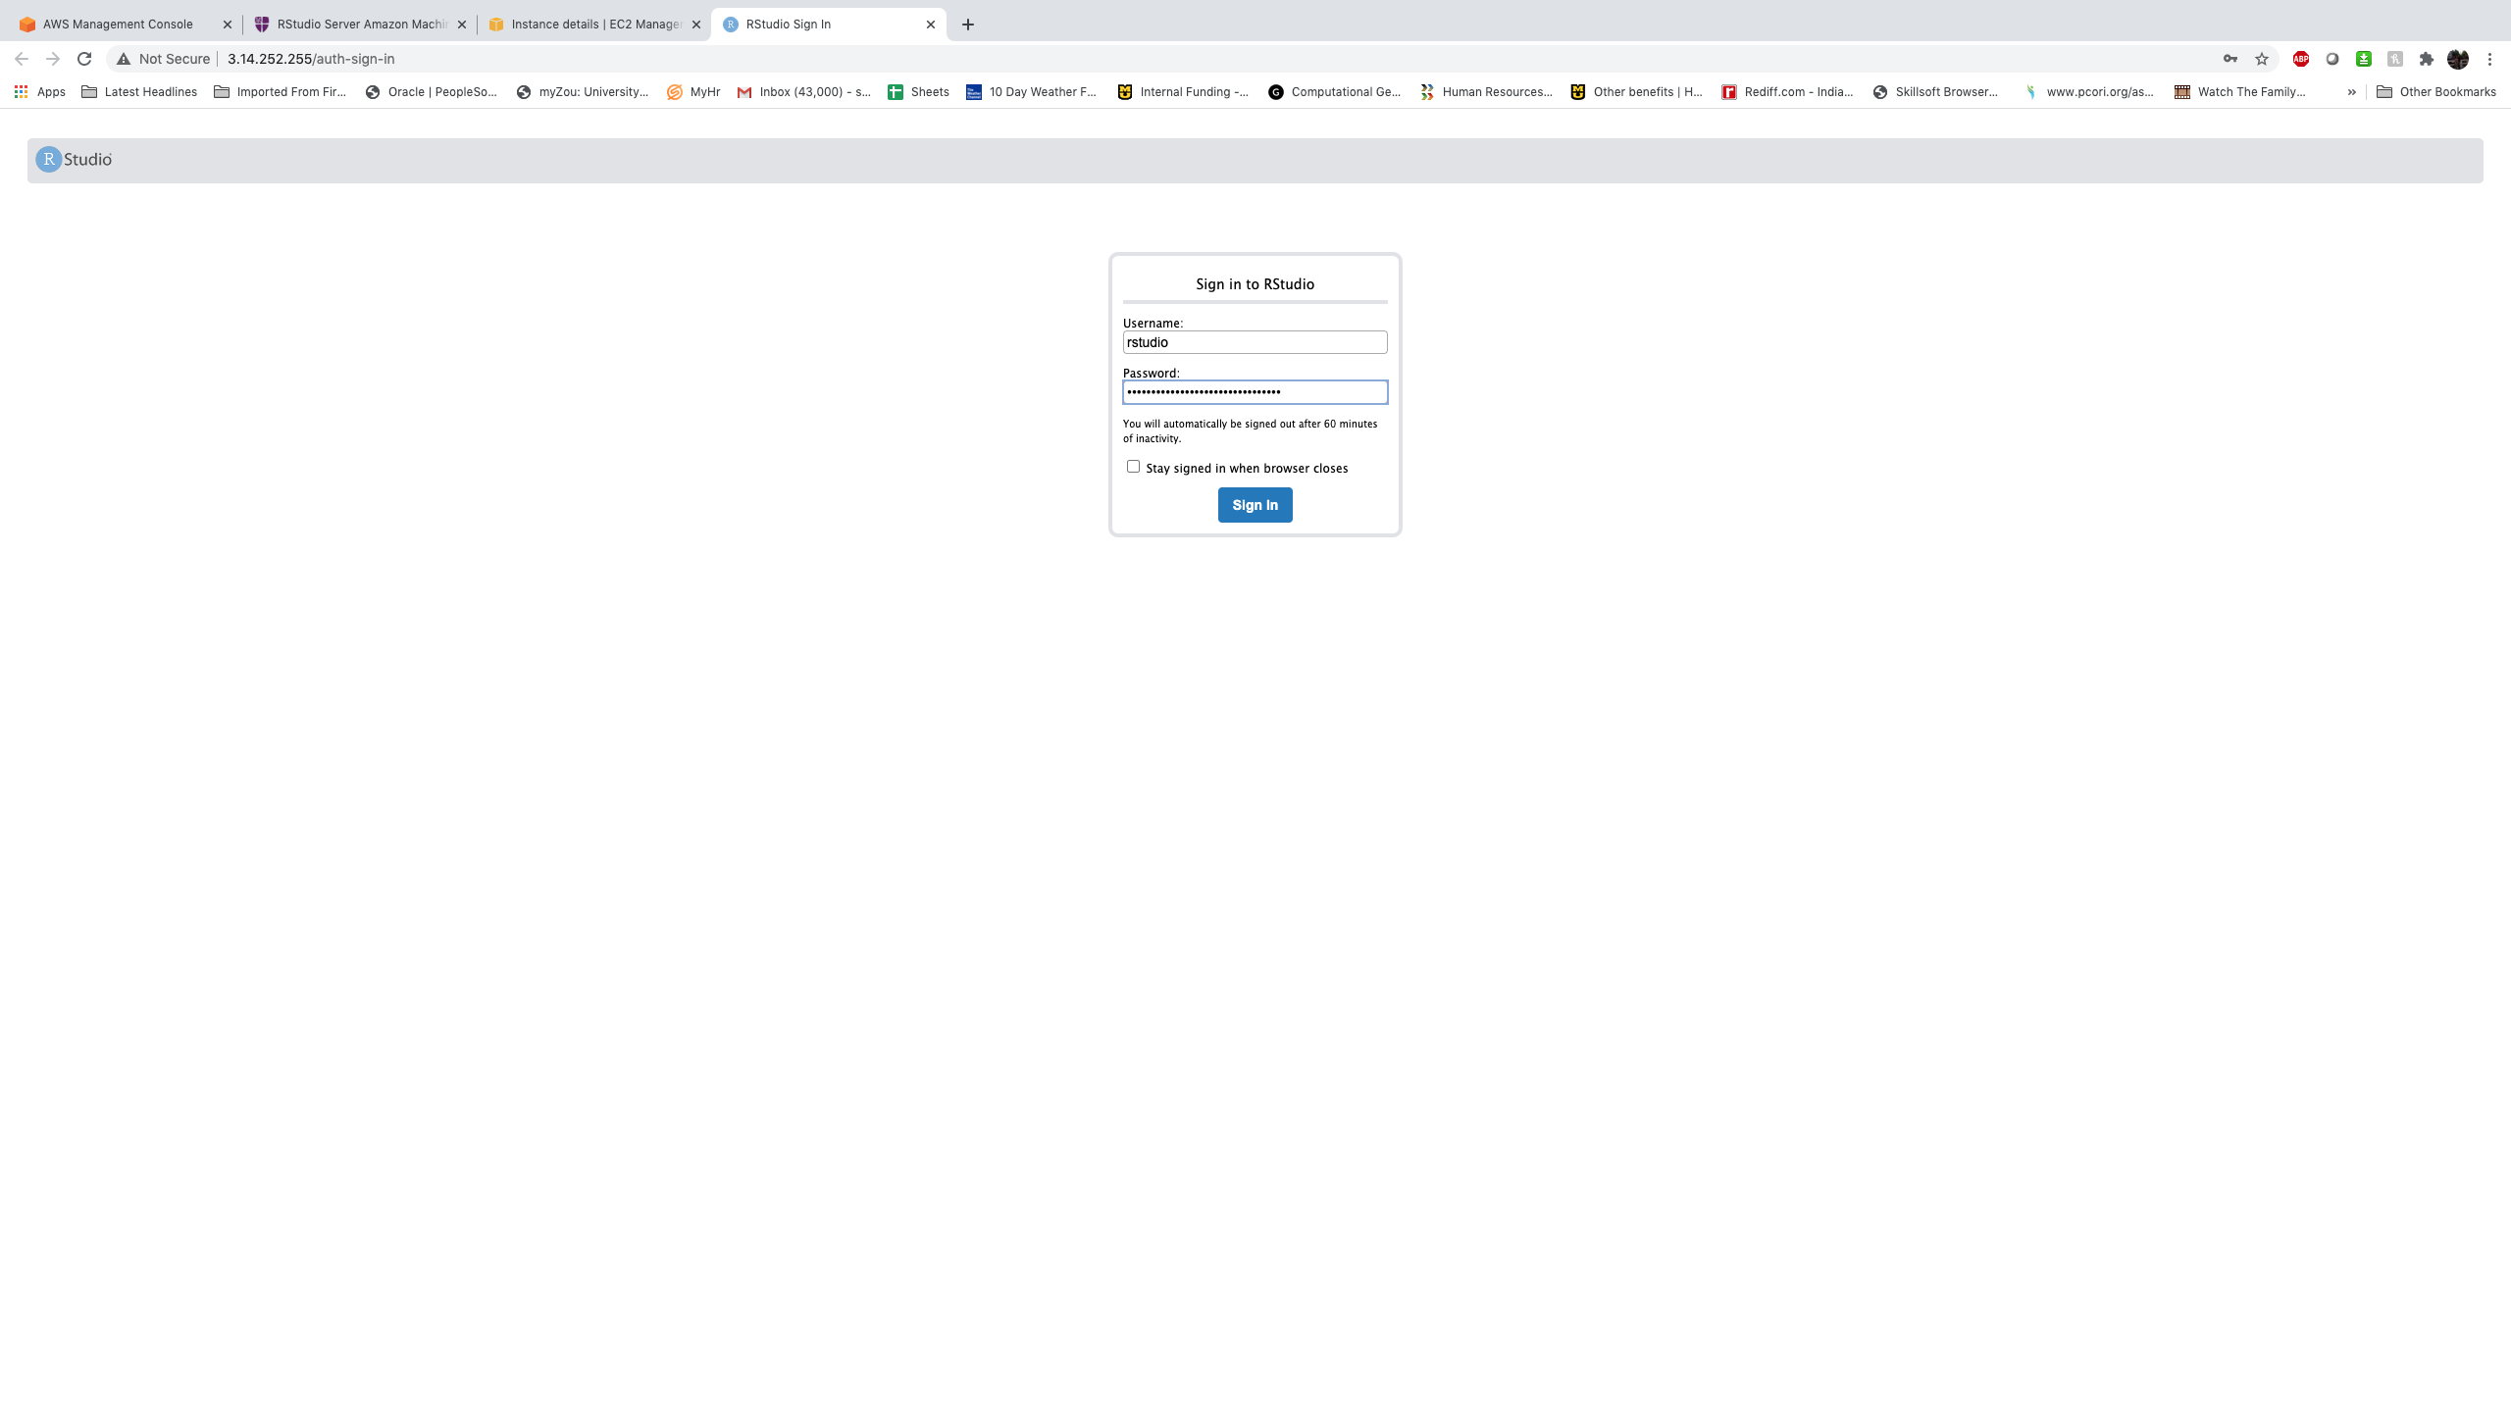
User name rstudio. password your instance id. Do not include “(myfirstaws)” in your instance id.

Slide 23
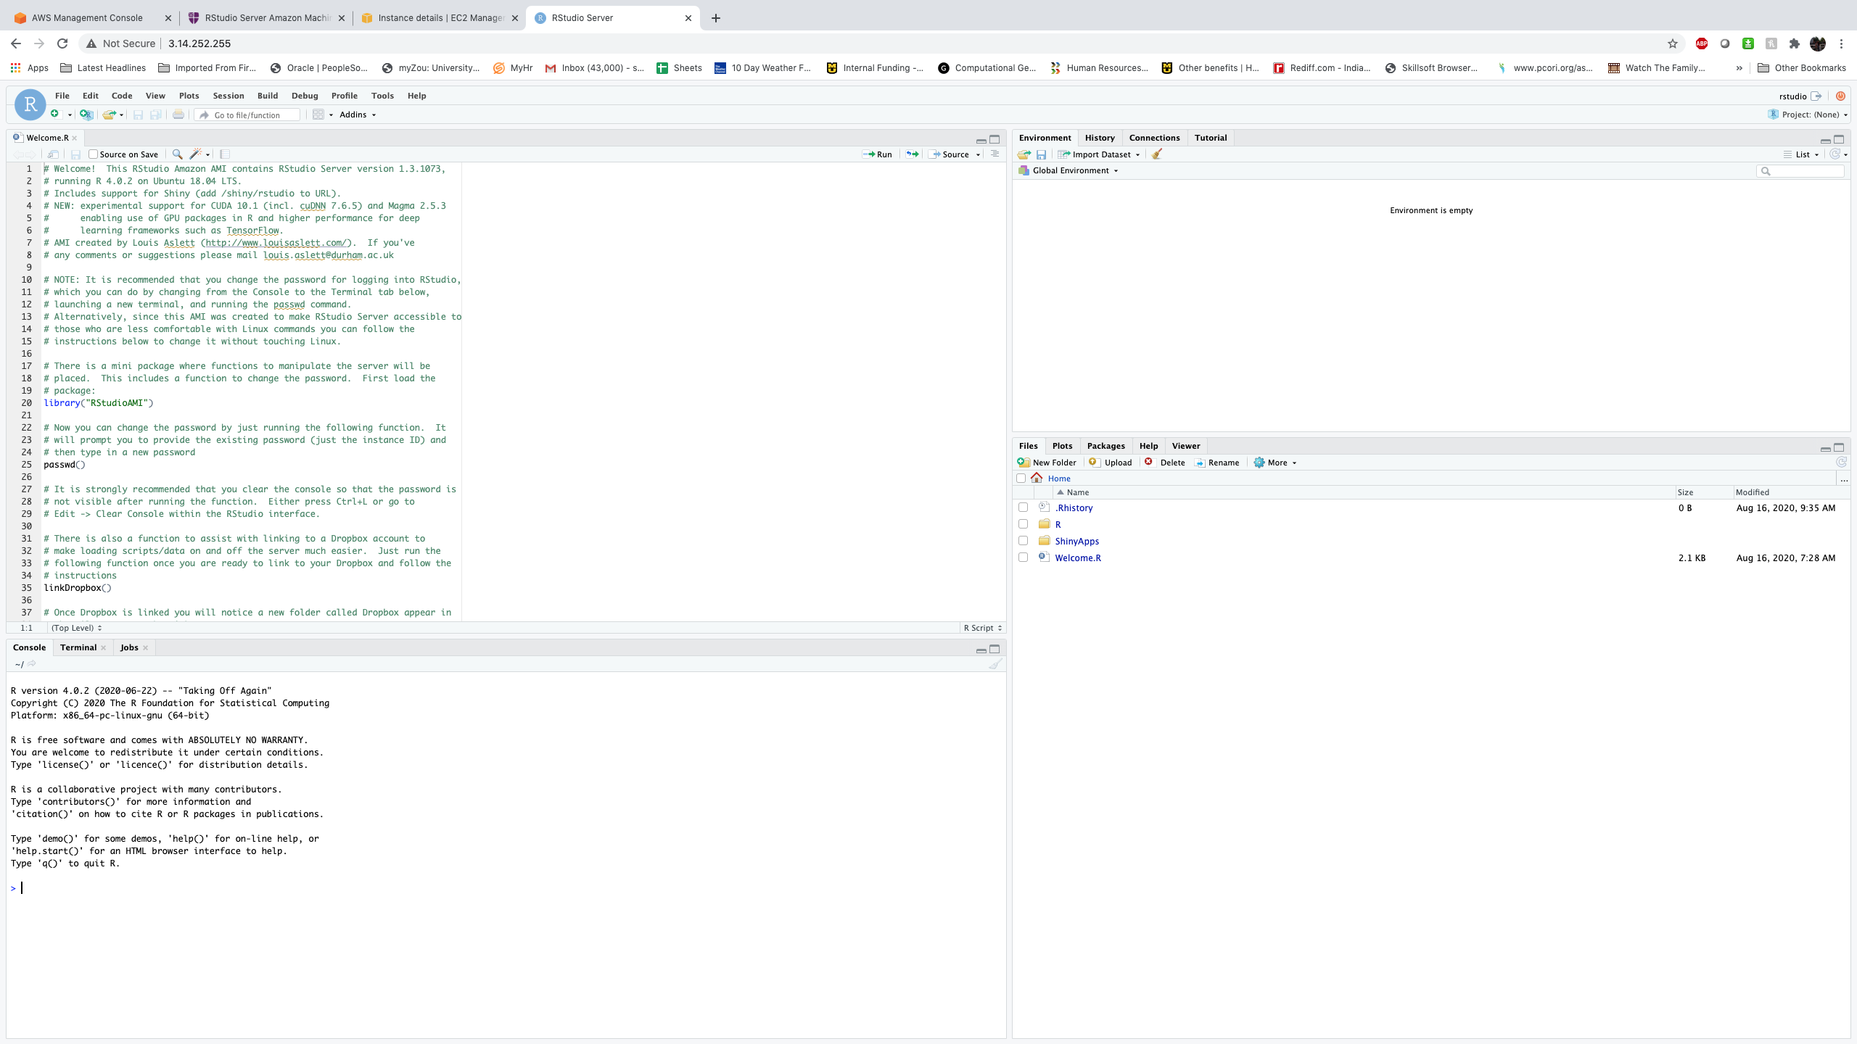
Congratulation you have launched rstudio in aws

Slide 24
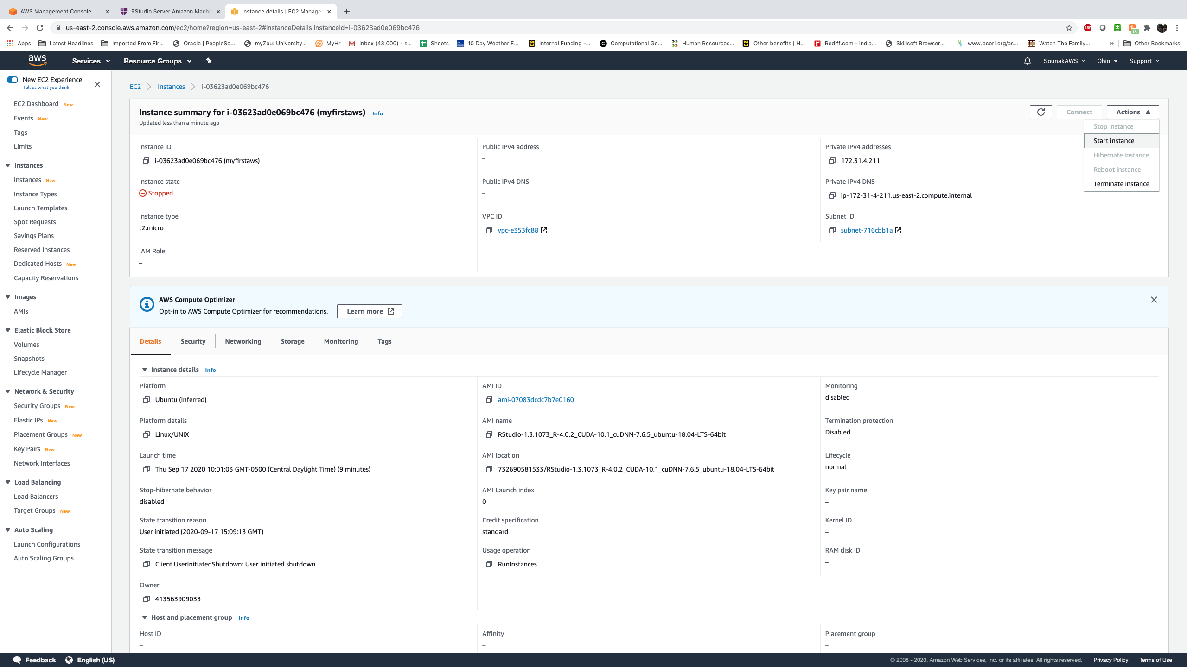
Quick steps to access a predefine ami and have your Rstudio up and running in almost no time

Slide 25
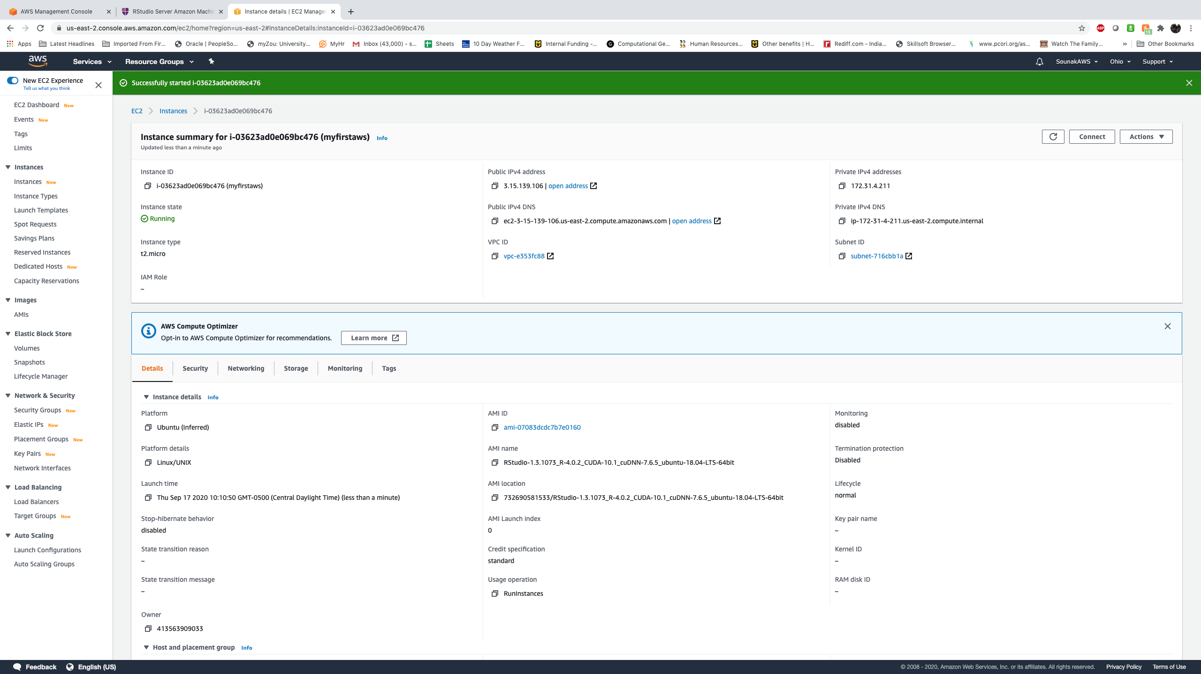

If you check instance details now it will show running.

Slide 26
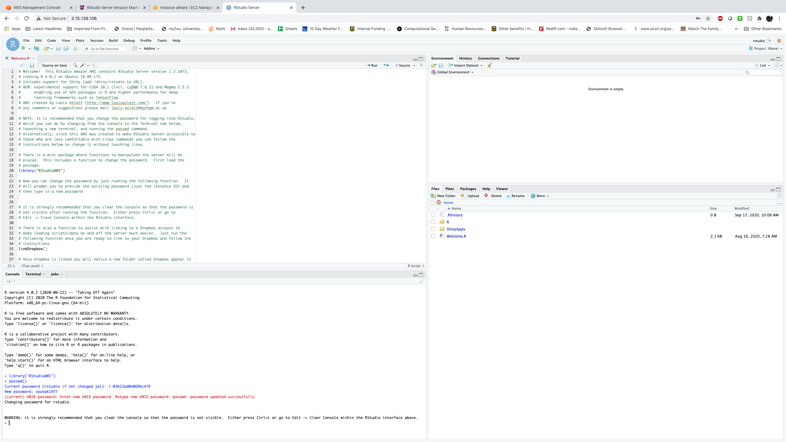
change password of Rstudio server
library(RStudioAMI)
passwd()
Current password: give instance id
New password: you give your new password

Slide 27
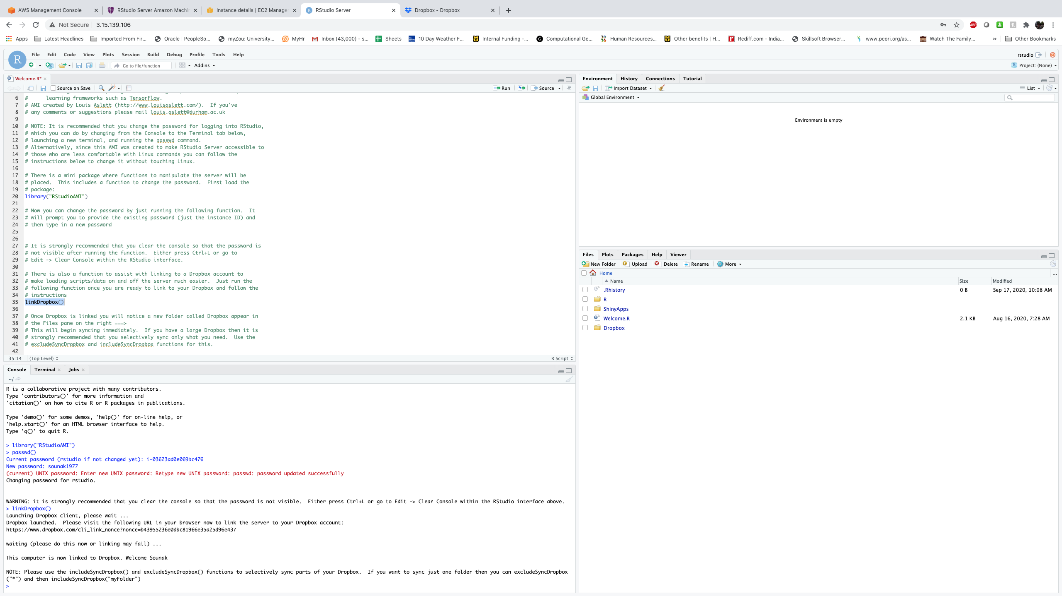
Connect dropbox by running linkdropbox(). Your Rstudio can now directly access your dropbox files.

Slide 28
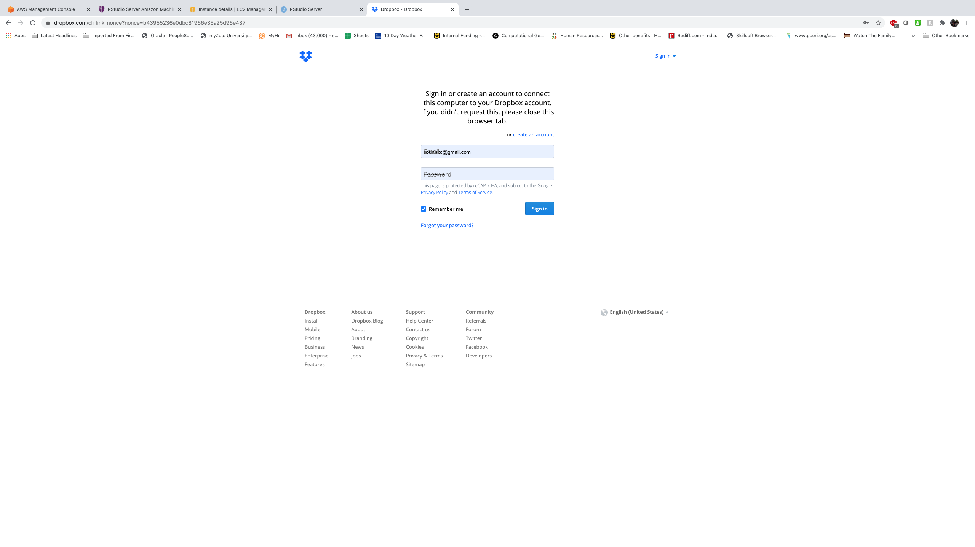
After running the linkdropbox() command in R it will open your dropbox login portal. Provide the necessary details to sign in.

Slide 29
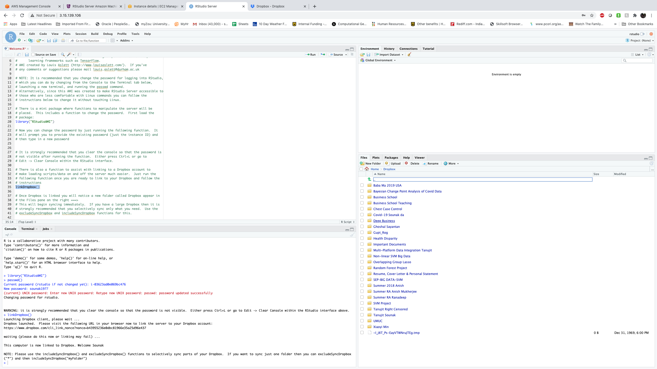

dropbox folders are now accessed in rstudio directly.

Slide 30
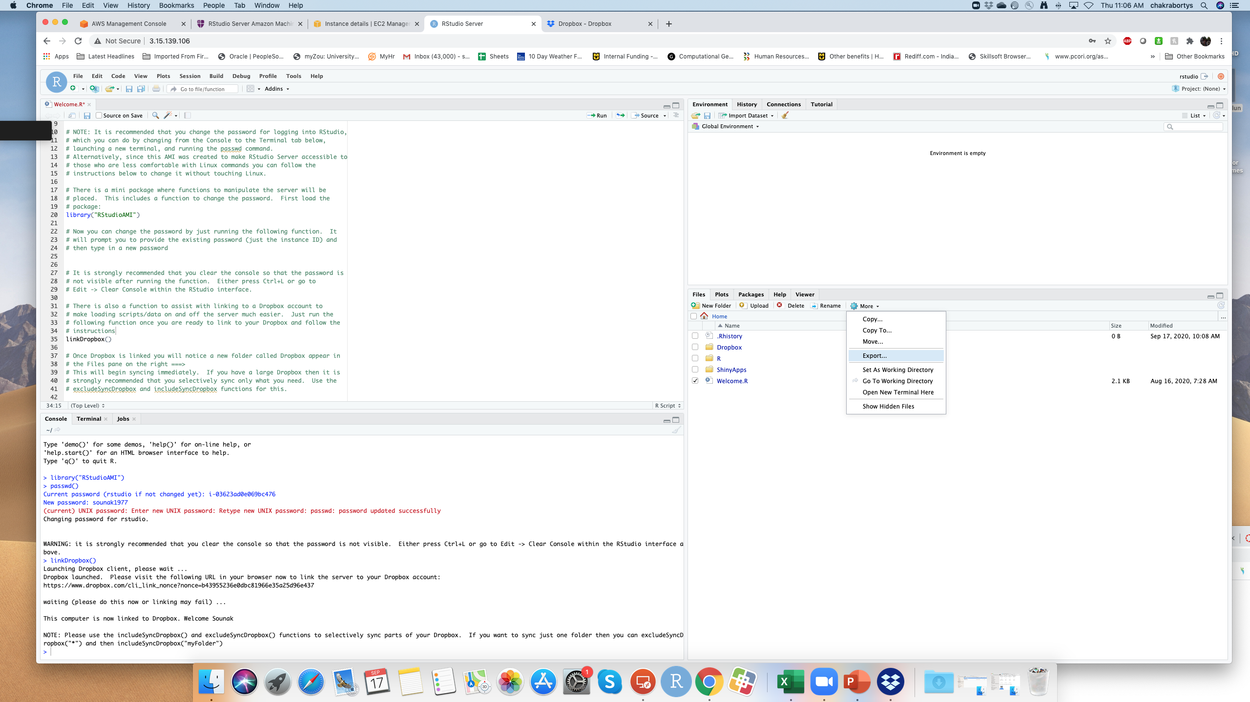

To download from rstudio cloud go to more then click on export and download the

Slide 31
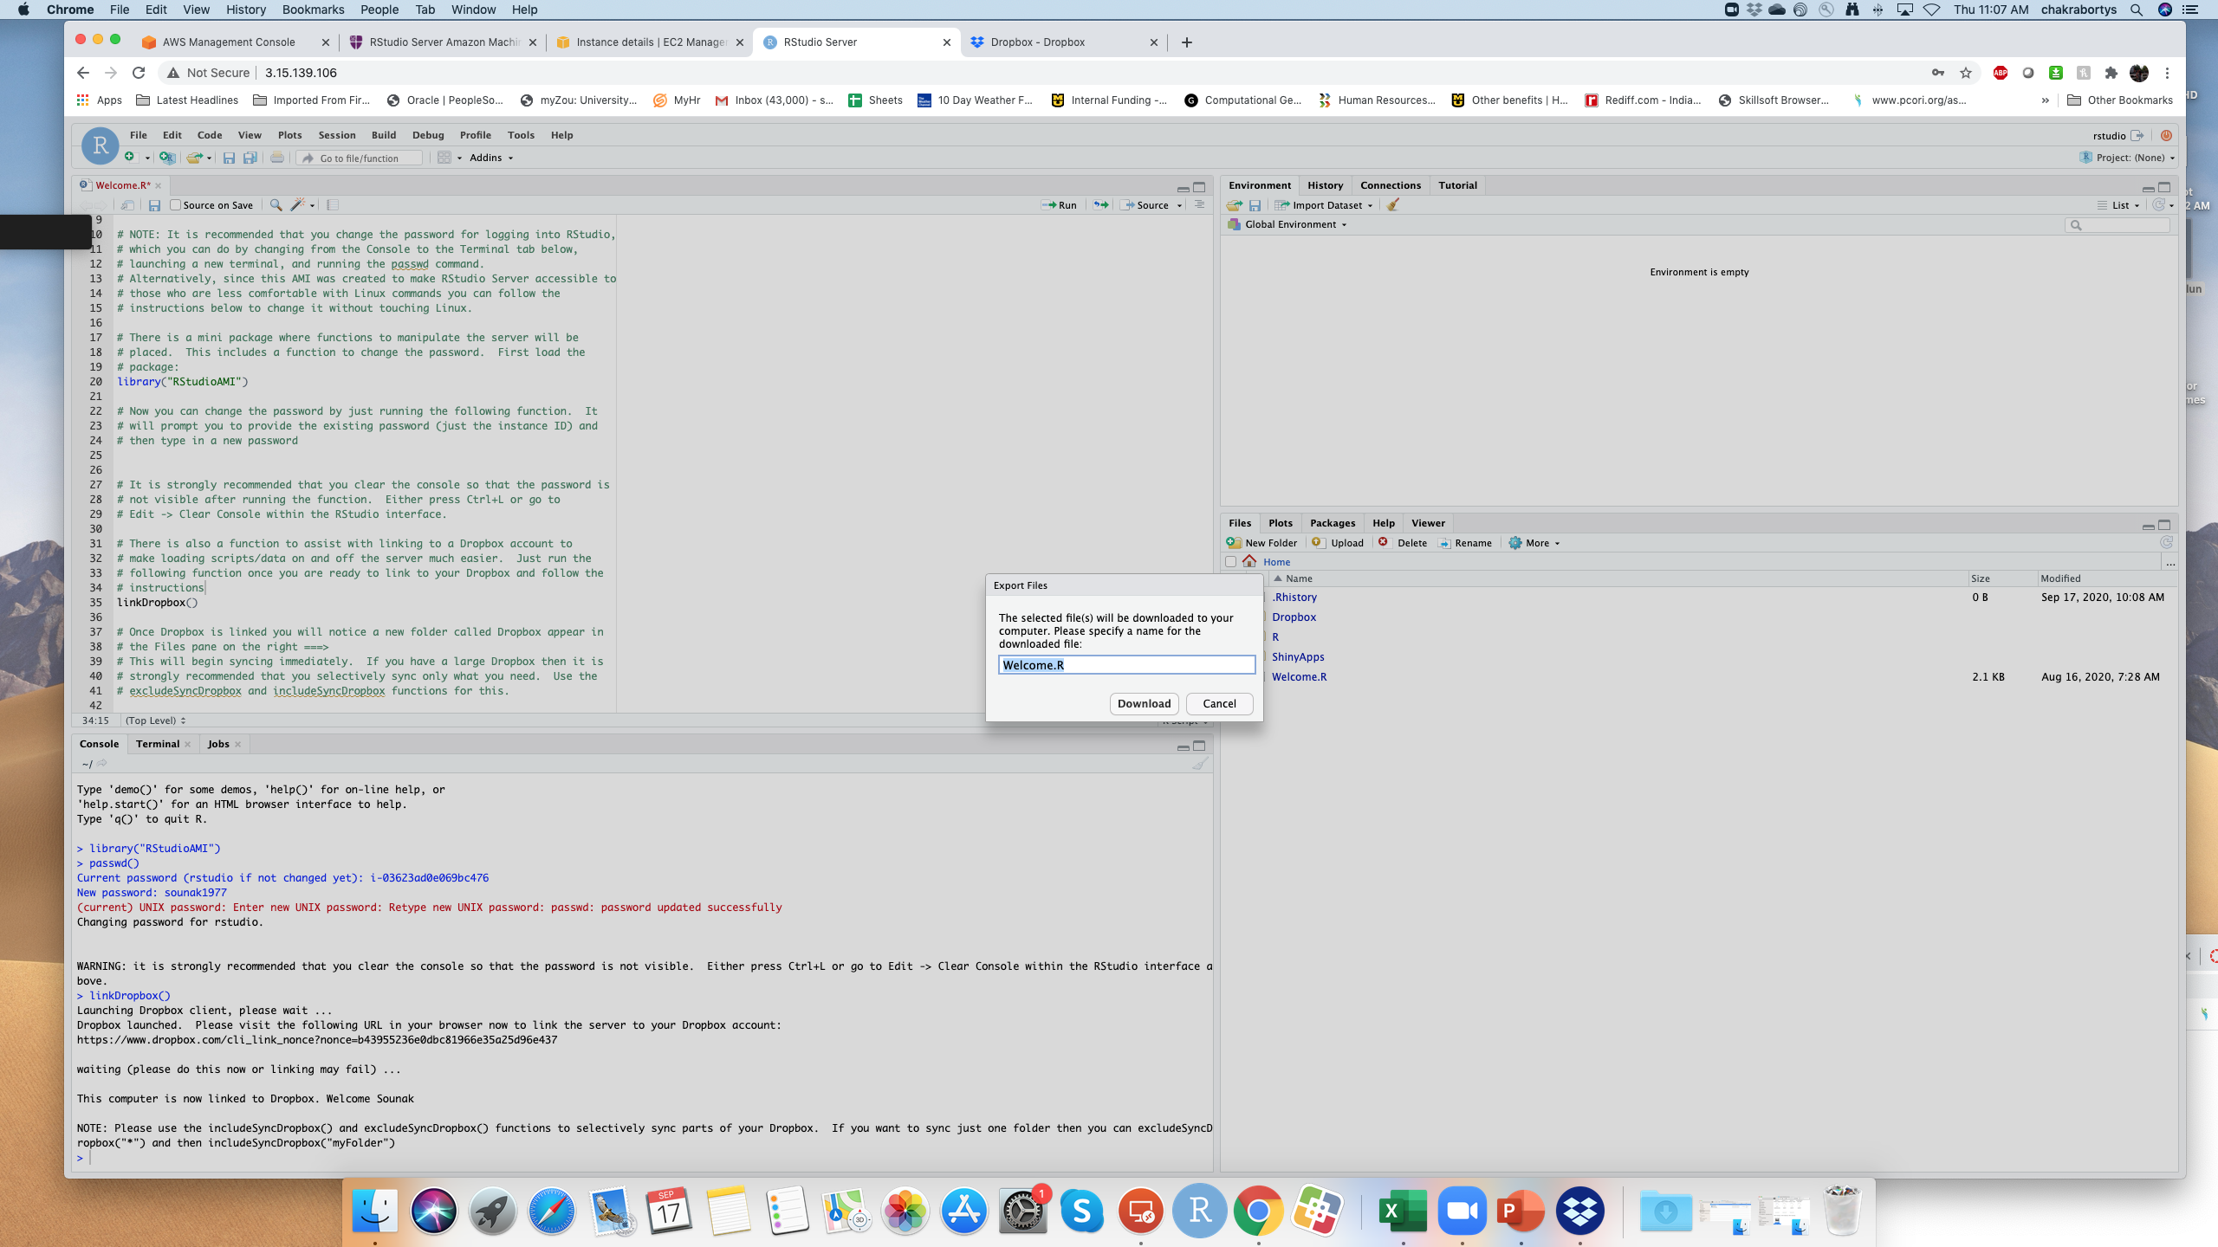

Downloading file from rstudio running on aws

Slide 32
Lets run a sample r code in rstudio server in aws
Run some of the r code from the file CodeSessionIntrotoR.R in Rstudio AMI we have just created.

Slide 33
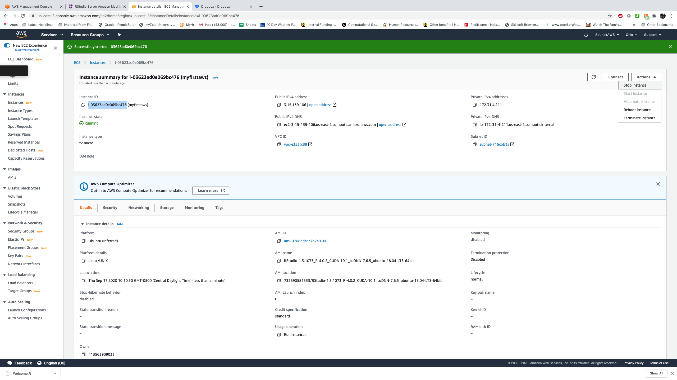

Stopping an instance in R studio

Slide 34
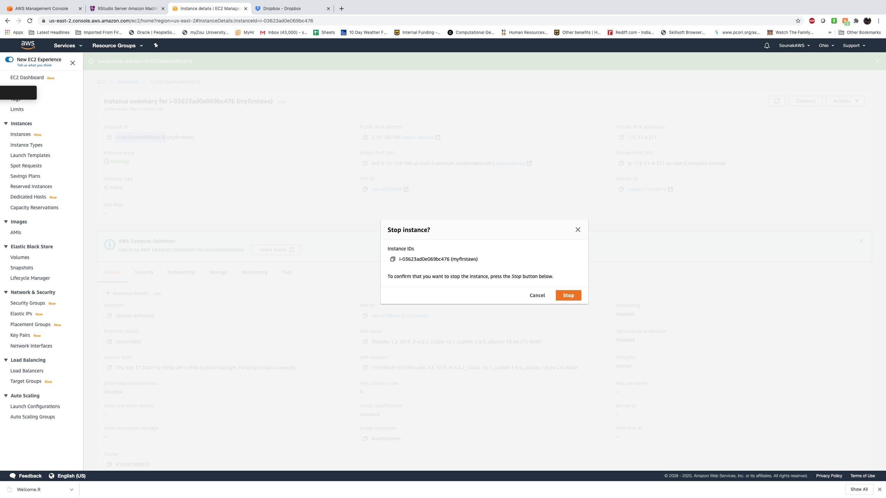

Stopping an instance in R studio

Slide 35
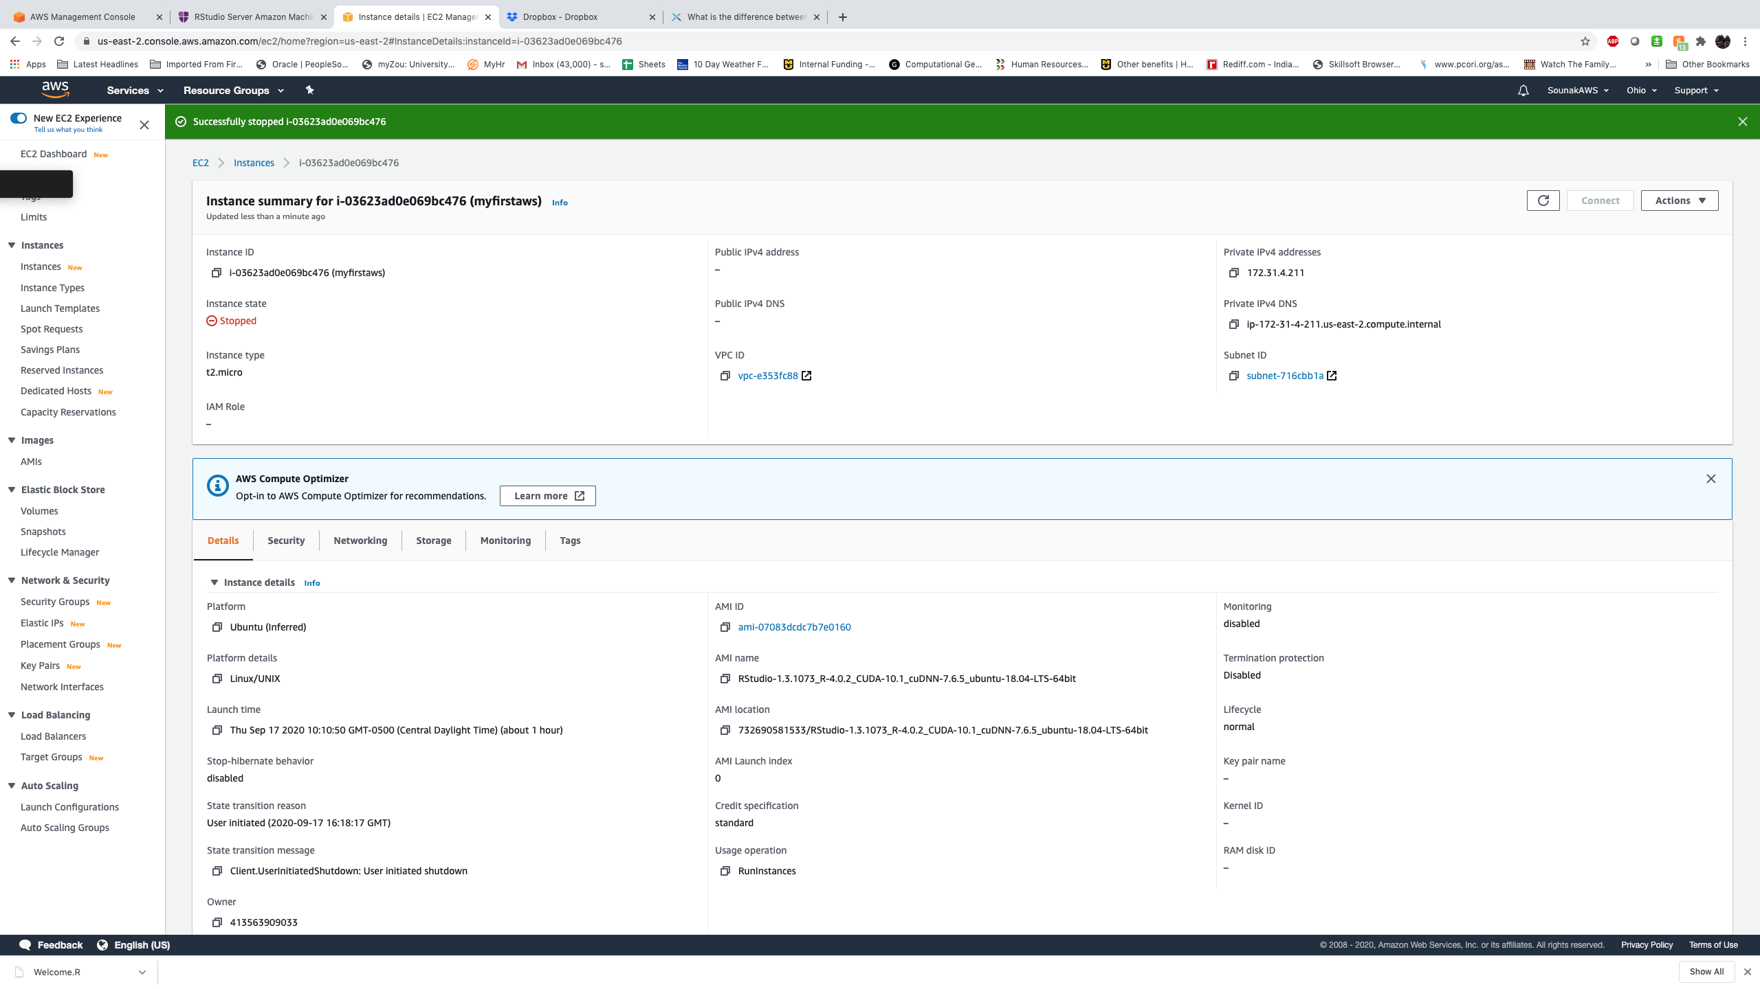

Stopping an instance in R studio

Slide 36
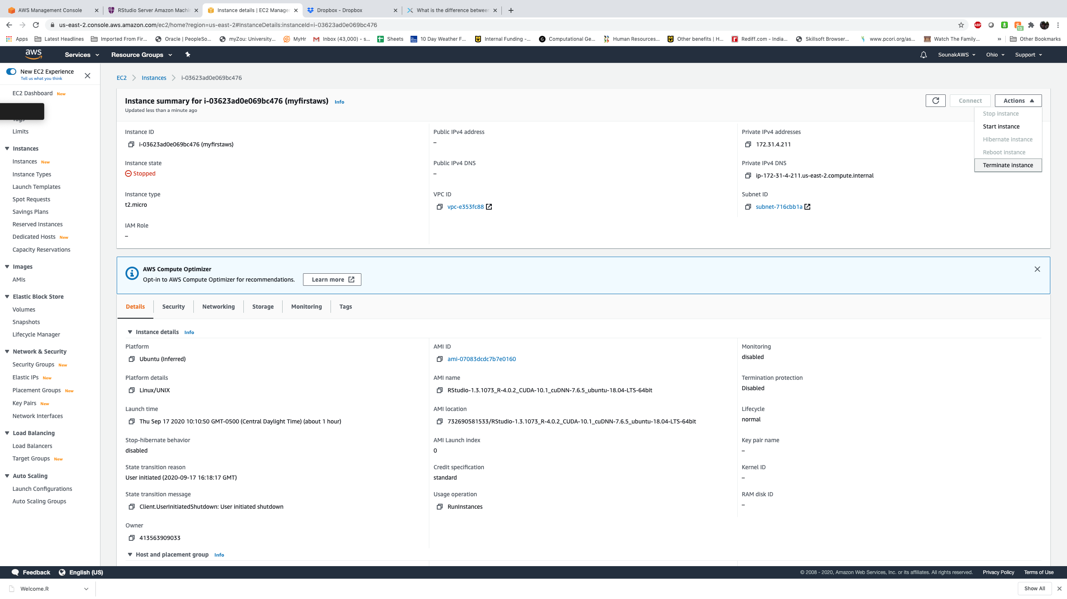

Terminating an instance in R studio

Slide 37
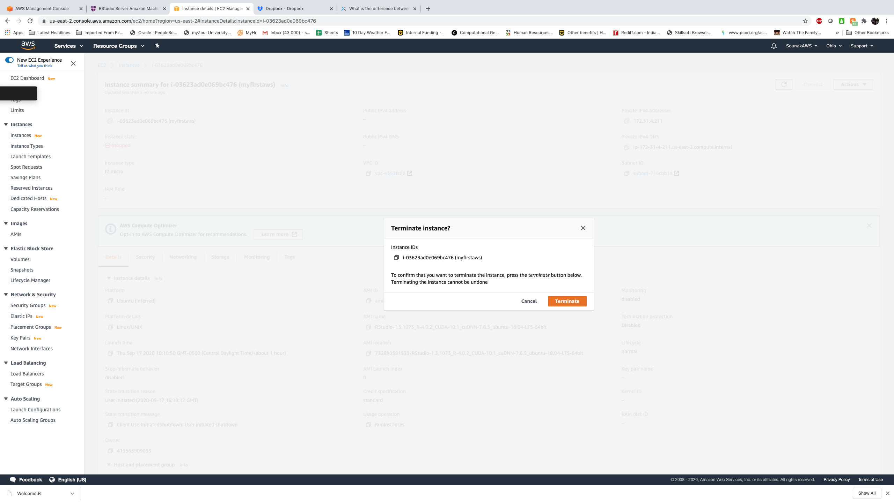

Terminating an instance in R studio

Slide 38
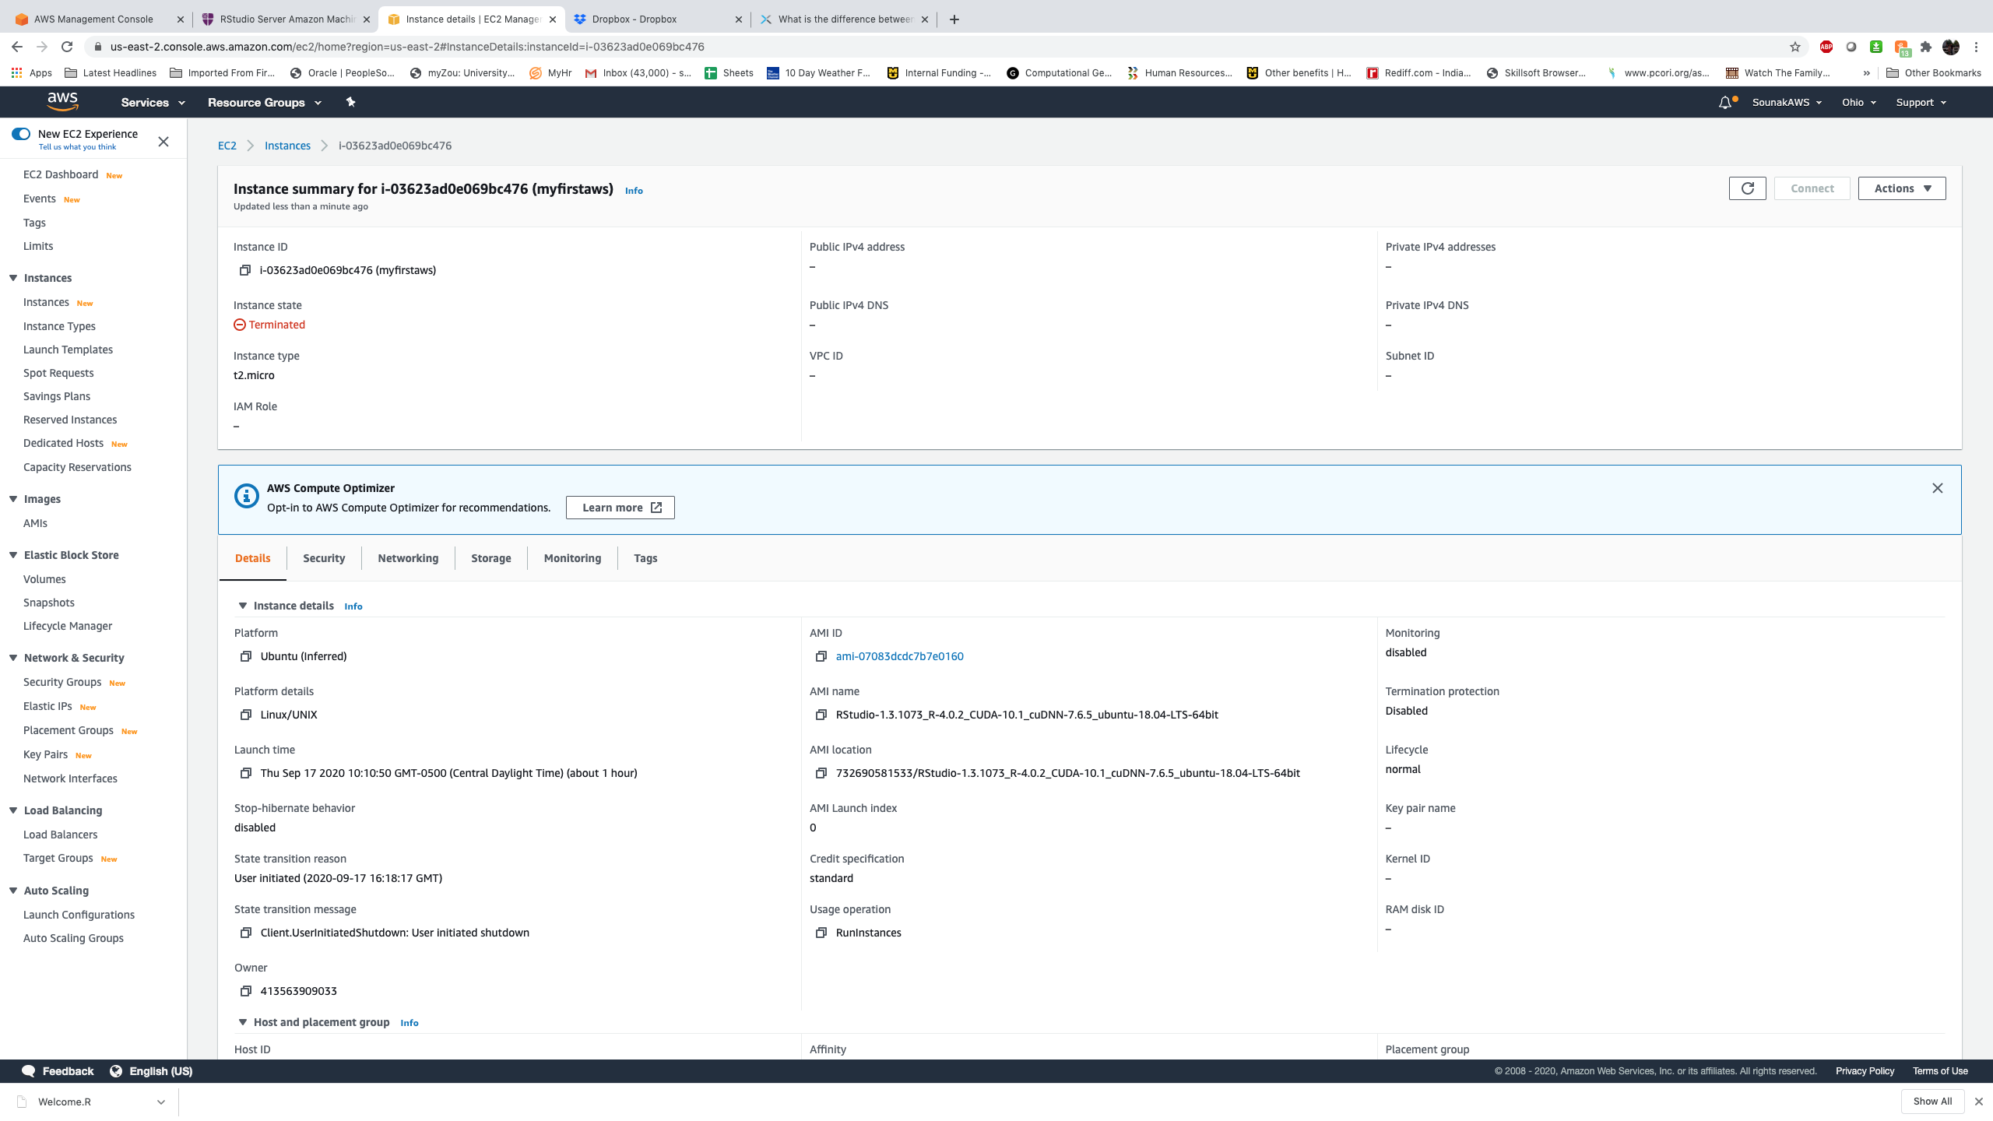

Terminating an instance in R studio

Slide 39
Stopping vs terminating know the difference
FAQ | Stopping | Terminating
What happens to the instance? | Root: root volume is preserved (EBS volume is not deleted) and other devices that are attached to the instance keep on running. Modification: Once the Instance State shows “stopped,” you have the ability to set the conditions you would like for it. you may change the instance type. Whether to scale up or down. at stopped mode, you can fix some system issues and do some updates, change the user data, RAM disk and kernel. | Root: The root and other devices attached to the instance when launched will all be deleted automatically. By default, the root volume is deleted following the termination. Modification: You cannot modify or connect to a terminated instance.
Can I restart the instance again? | yes | no
Do I get billed? | No: usage per hour; data transfer fees Yes: storage fees (EBS volume); every time you restart a stopped instance, you get charged for a full hour (even you will do this once or many times within one hour) | No. On Free Tier, you do not get charged when you terminate an instance and create a new micro instance.
What happens to my IP address? | EC2 VPC: Your private IP remains the same. Gets a new public instance only if you don’t have an EIP EC2 Classic: You get a new public and private IP when the instance is restarted (so the EIP previously linked with the private IP is no longer associated with the instance) | The EIP associated to your instance will be disassociated.
Why stop an instance? | cannot perform an instance status check; doesn’t run applications well; to scale up or down; to modify user data, kernel, RAM | You have decided that you no longer need it.

Slide 40
What did we learn ?
What is aws ec2
How to set up RStudio server in AWS and run code using an existing AMI

Slide 41
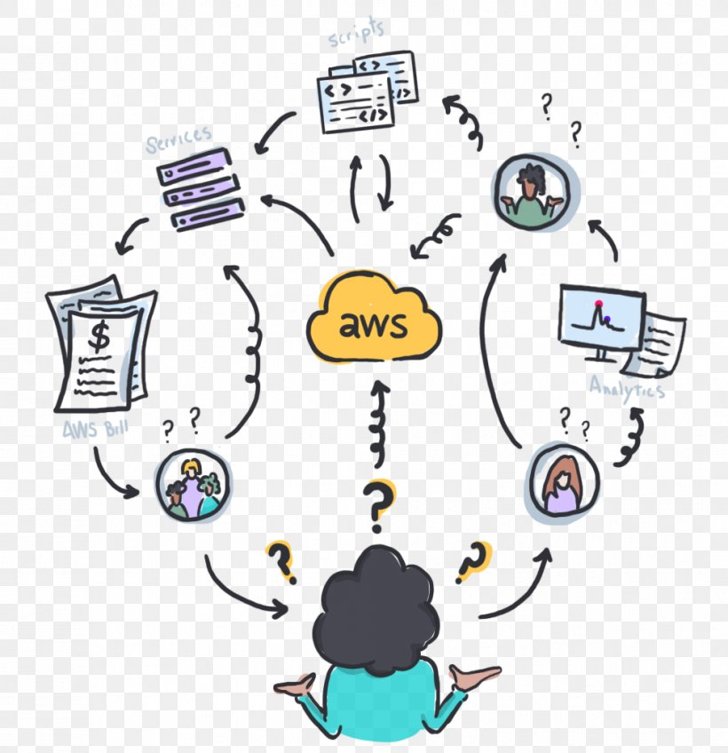
THANK YOU SOUNAK CHAKRABORTY CHAKRABORTYS@MISSOURI.EDU http://faculty.missouri.edu/chakrabortys/

